Slide 1
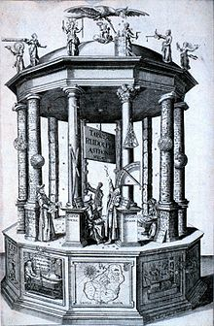
The Scientific Revolution
Changing The Way the World Thinks About Science

Slide 2
Big Picture Questions
During the Scientific Revolution, people started to question things about the world that they hadn’t thought to before.
Think about the following questions- based on what you can see in the world around you and not what we now know based on science!!

Slide 3
GET READY TO THINK LIKE A PERSON IN THE 1600s!

Slide 4
Question 1
Why does it get dark at night?

Slide 5
Question 2
What are stars?

Slide 6
Question 3
Does the world revolve around the sun? If you go outside and look at the sky- is there any proof that it does?

Slide 7
Question 4
Are all things are made of tiny atoms? Based on what you can see.

Slide 8
Question 5
What causes people to get sick?

Slide 9
Question 7
Can you think of any other things that we know today to be true because of science- but they may not have known in the 1600s?

Slide 10
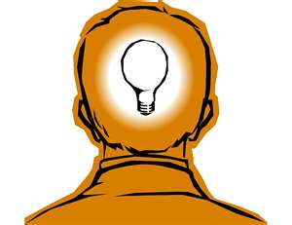
Before the Scientific Revolution…
People did not have the answers to these questions before the Scientific Revolution- they had theories, but no true answers
Most people still found their “Truth” from the church and whatever it taught to be true was excepted- despite growth in this area made by the Reformation

Slide 11
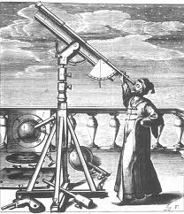
Background information
The scientific revolution began at the end of the Renaissance
It started in 16th century and lasted through the 1800s
A textbook definition is: A rapid development of science and thought based on the trust in fact and progress

Slide 12
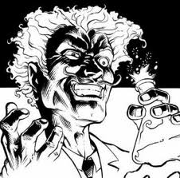
Consequences of new thoughts
Many scientists faced persecution for their ideas
Some were labeled as heretics (someone who goes against the teachings of the church)
Others were simply labeled insane

Slide 13
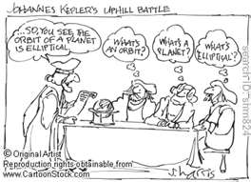
New Ideas
Those the theories presented on the next few slides may not seem that impressive to us, the ideas were brand new during the Scientific Revolution and were life changing for most!

Slide 14
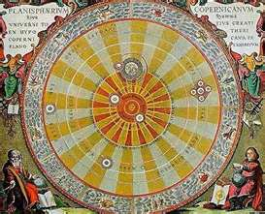
New Ideas- 1
BEFORE
AFTER
The earth is the center of the universe and everything revolves around it
The sun is the center of the universe and the earth and planets revolve around the sun

Slide 15
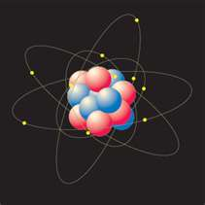
New Ideas- 2
BEFORE
AFTER
Everything is made up of one of the 4 “elements”- Earth, wind, fire, water
Everything is made up of atoms

Slide 16
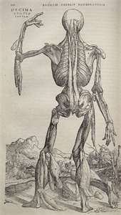
New Ideas- 3
BEFORE
AFTER
The body had many systems that each have their own supply of blood
Blood is transported throughout the entire body through the veins

Slide 17
Accomplishments
Despite the fact that many people may not have bought into these new scientific discoveries back then- they paved the way for our world today!
Without the Scientific Revolution we wouldn’t have modern science like we do today!

Slide 18
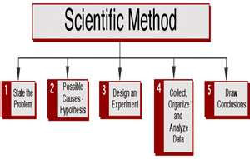
Accomplishments Cont.
One of the most important contributions was the Scientific Method
The Scientific Method was created by Galileo as a way to study science and come up with accurate results

Slide 19
Stop and Think
1. Why would it make sense that this revolution would come after the Renaissance? What new things were they doing during the Renaissance that would lead into the Scientific Revolution?
2. Do any of the ideas presented today seem SOO crazy or new? Why do you think people hard such a hard time accepting these ideas back then?

