Slide 1
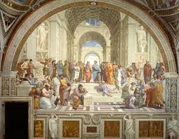
The Renaissance
Introductory Notes

Slide 2
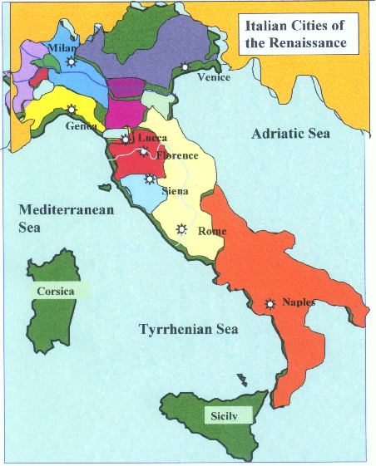
Renaissance- A Definition
Definition: Rebirth
Rebirth of learning, arts, and culture
The Renaissance was a time period from 1400-1600
Began in Italy and spread throughout Europe
Ancient Greece and Rome greatly influenced Renaissance culture

Slide 3
The big question is: A rebirth of what?

Slide 4
Life before the Renaissance…

Slide 5
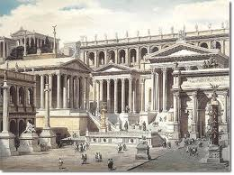
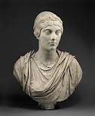
A Rebirth
Before Medieval Times, learning and the arts had been highly valued during Classical Times (the height of the Greek and Roman empire)
During the Renaissance people started to look back to the Classical Times and rediscover them and also breathe new life into these ideas

Slide 6
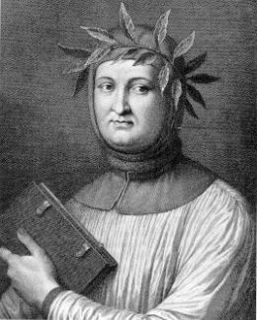
The Father of the Renaissance
Many people trace the Renaissance back to a man named Petrarch
Petrarch was a poet but had a great love of writing and learning
He wanted people to leave behind the Dark Ages and move forward

Slide 7
Petrarch Cont.
Petrarch lived through the Black Plague and experienced much death. He wanted to overcome the present times he lived in
He saw education and learning as a bridge to the future and challenged the ideas of the church
Petrarch developed the idea of Humanism which means:
A belief system that focuses on the importance of humans and their ideas
A system that rejects religious beliefs and focuses on the ideas and importance of individuals in shaping their own lives

Slide 8
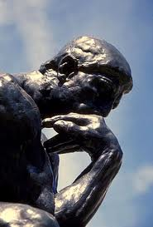
Stop and Think
Why would people like the ideas of Petrarch in the Dark Ages?

Slide 9
So with the birth of Humanism and men such as Petrarch, The Dark Ages ended and the Renaissance began

Slide 10
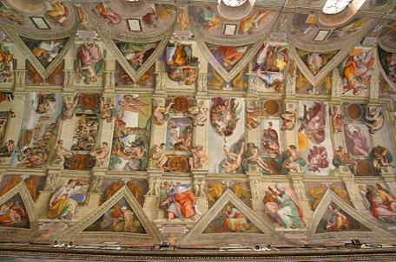
Areas that flourished:
During the Renaissance many areas flourished:
Art
Painting
Sculpture
Literature
Science
Architecture
Mathematics
Education

Slide 11
A Renaissance Man
Have you ever heard the phrase “He is a Renaissance Man” ?
While Petrarch is known as the father of the Renaissance, he was not your ideal Renaissance man.
This phrase refers to a man who is talented in many fields
Just like the Renaissance was a rebirth of many different fields, a Renaissance man is a man who is talented and accomplished in more than one field
We might call them today a “Jack of All Trades”

Slide 12
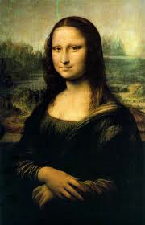
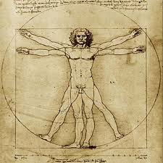
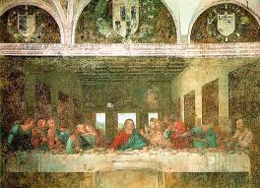
The Ideal Renaissance Man
The very first Renaissance Man was Leonardo Da Vinci
You may know him from some of his famous works:

Slide 13
Renaissance Man!

Slide 14
Check your understanding!
1. What is the definition of Renaissance?
2. What fields or subjects advanced during the Renaissance?
3. What is a Renaissance Man?
4. What is humanism?

