Slide 1
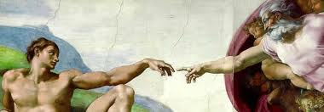
Renaissance Art

Slide 2
Renaissance Art
The word Renaissance means rebirth.
To truly understand how the Renaissance it is important to understand the important role art played during this time period.
Rich patrons paid artists to create works of art during the Renaissance.
Art during the Renaissance was very unique and used many new methods but to understand it, you must understand the art that came before it

Slide 3
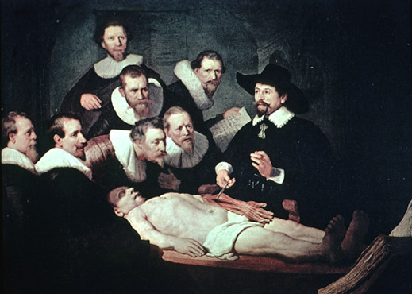
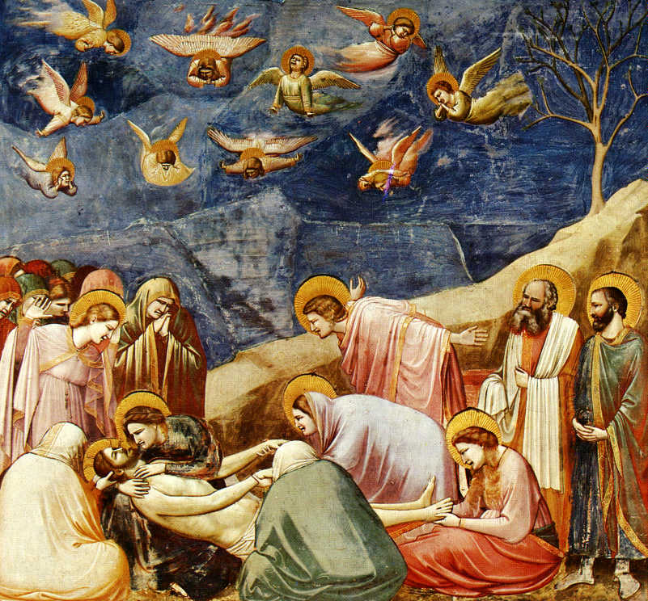
Art Comparison
Answer these questions for both pieces of art.
Describe what you see in each picture.
Which pictures seem to be more realistic?
1
2

Slide 4
Classical Art
The Classical Period lasted from 500 BC to 500 CE
Classical art was characterized by:
Figures were lifelike, but sometimes idealized
Figures were nude or draped in togas
Bodies looked like they were in action
Faces were calm and had little emotion
Scenes showed either heroic figures or people doing everyday tasks

Slide 5
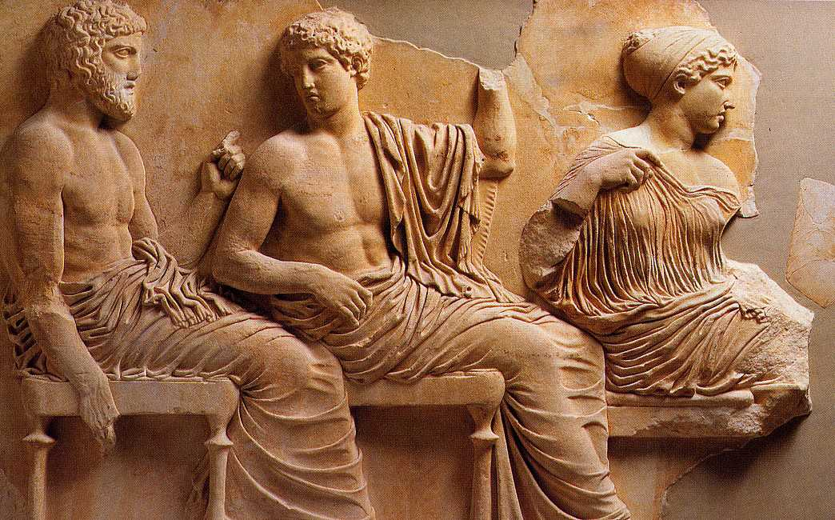

Slide 6
Medieval Art
The Medieval Period lasted from 500 to 1300
Medieval Art was characterized by:
Most art was religious
Important figures in paintings were larger than other parts of the painting
Figures were often stiff and lacked movement
Faces were serious and lacked emotion
Paintings were flat and lacked depth
Paint colors were bright
Backgrounds were mostly one color- often gold

Slide 7
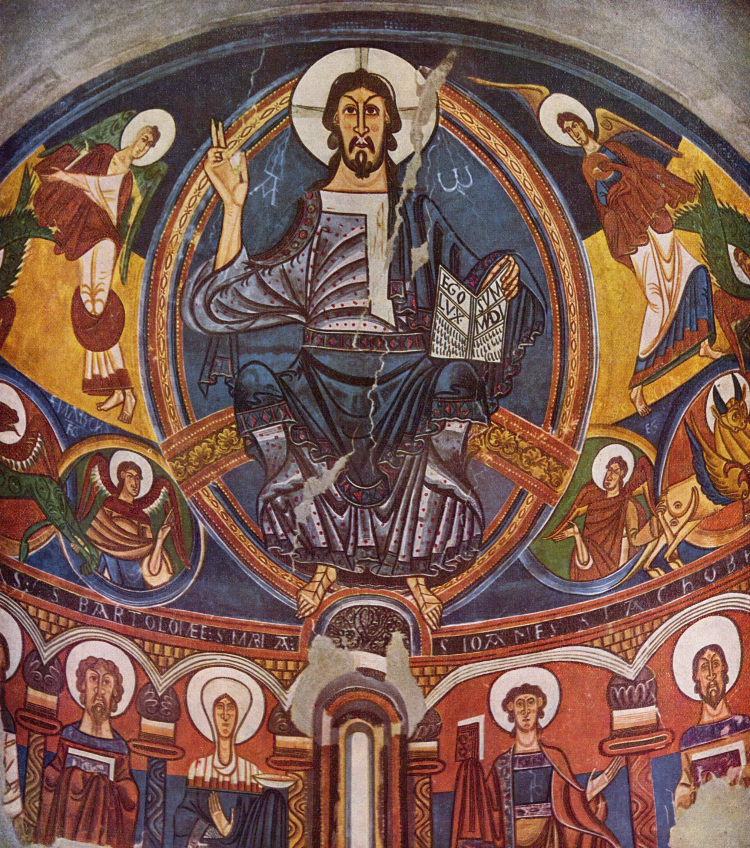

Slide 8
Renaissance Art
The Renaissance period lasted from 1300-1600
Renaissance art was characterized by:
Art showed religious AND non-religious scenes
Art reflected an interest in nature
Figures were lifelike
Bodies were active
Faces expressed what people were thinking
Colors were shown to represent light and shading
Paintings were often symmetrical or balanced
Backgrounds showed perspective and depth

Slide 9
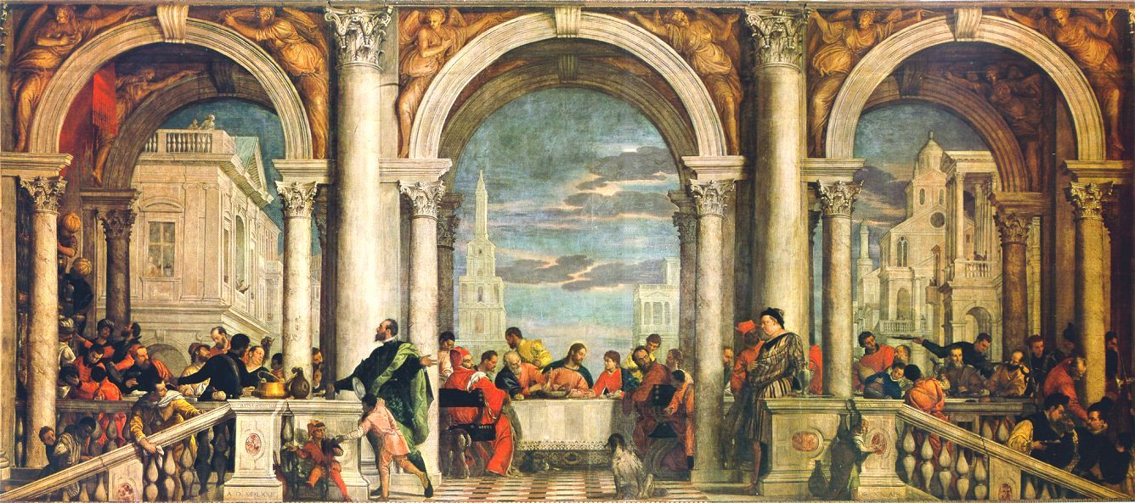

Slide 10
Can you classify these paintings?
As you view the paintings on the next few slides classify them as:
C for Classical
M for Medieval
R for Renaissance
Use the clues you just learned to help you!

Slide 11
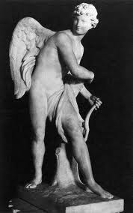
1

Slide 12
1
Classical!

Slide 13
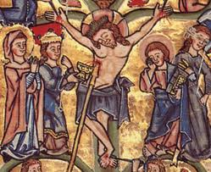
2

Slide 14
2
Medieval!

Slide 15
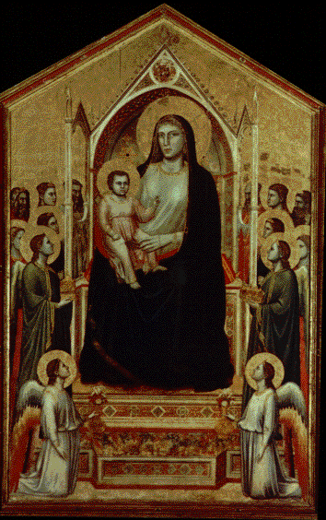
3

Slide 16
3
Medieval!

Slide 17
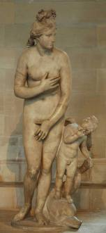
4

Slide 18
4
Classical!

Slide 19
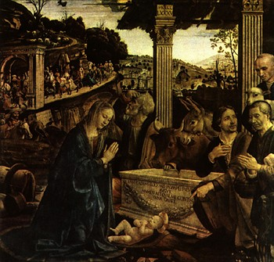
5

Slide 20
5
Renaissance!

Slide 21
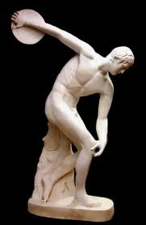
6

Slide 22
6
Classical!

Slide 23
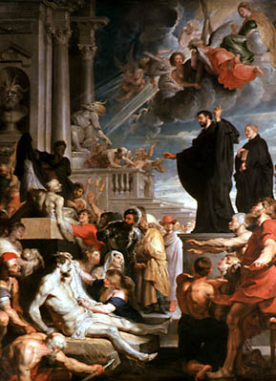
7

Slide 24
7
Renaissance!

Slide 25
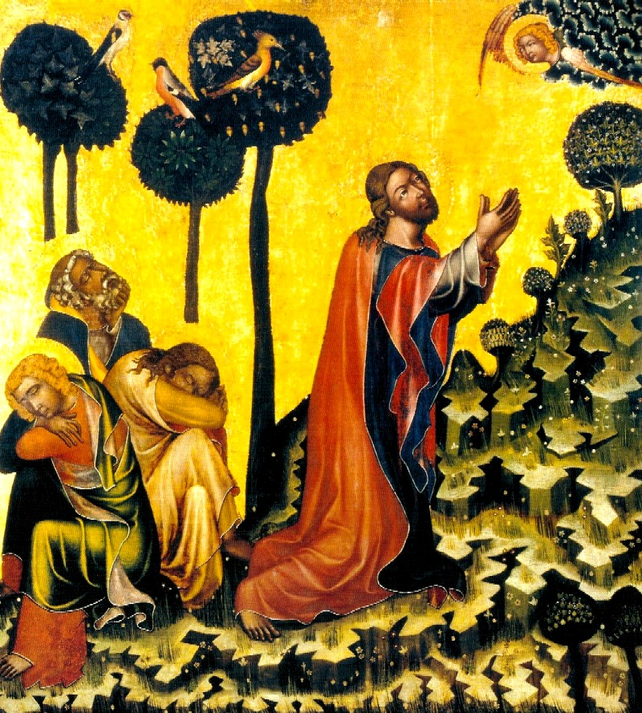
8

Slide 26
8
Medieval!

Slide 27
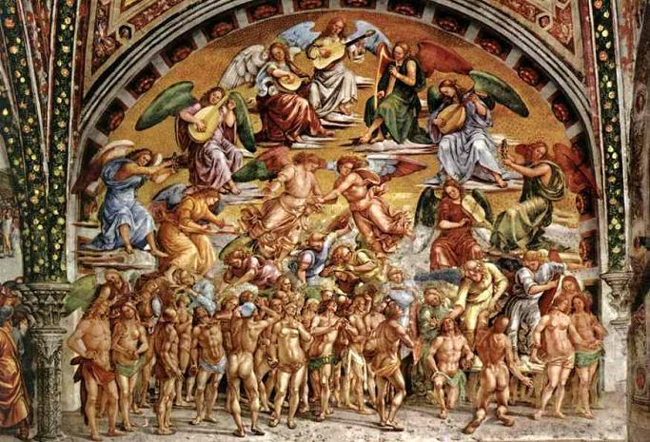
9

Slide 28
9
Renaissance!

Slide 29
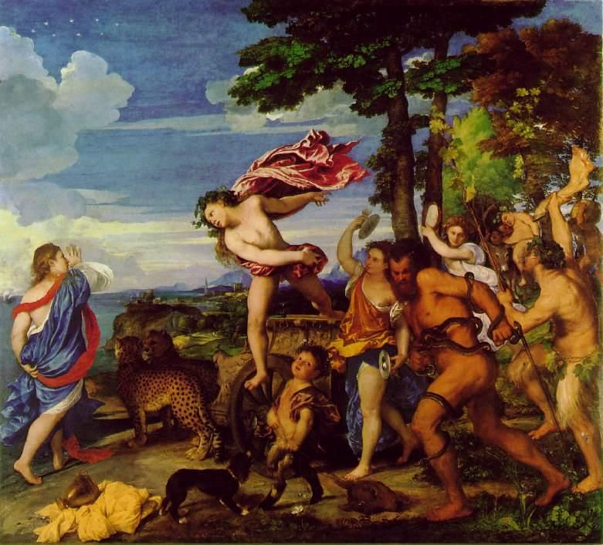
10

Slide 30
10
Renaissance!

Slide 31
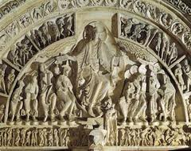
11

Slide 32
11
Medieval!

Slide 33
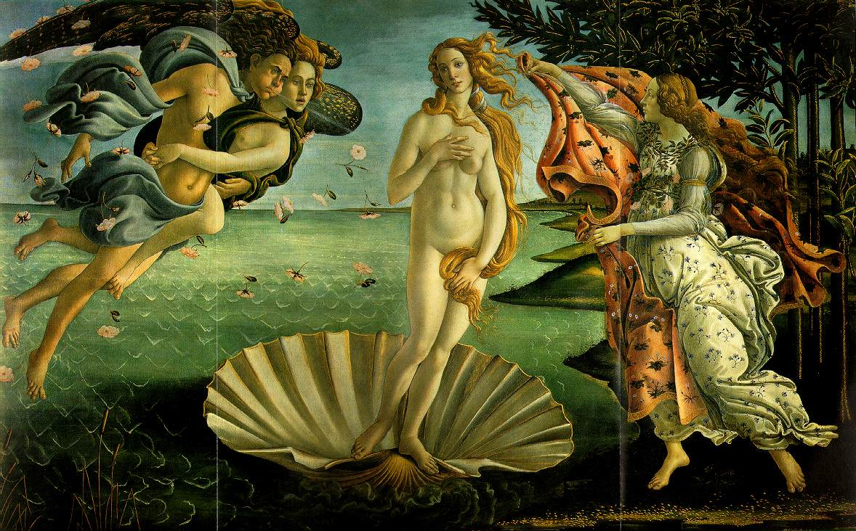
12

Slide 34
12
Renaissance!

Slide 35
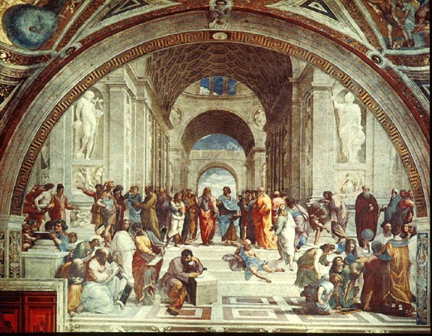
13

Slide 36
13
Renaissance!

Slide 37
Stop and Think
Which period of art do you like the best?
Which period of art seems to be the most realistic?

Slide 38
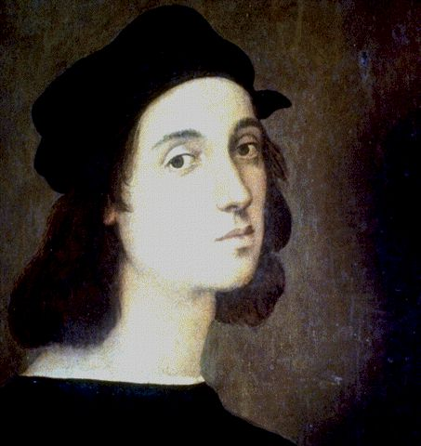
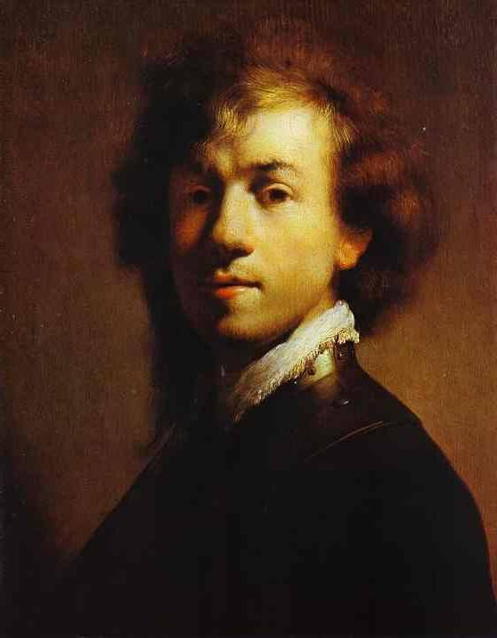
Four Geniuses of the Renaissance Art
Raphael
Da Vinci
Michelangelo
Rembrandt

Slide 39
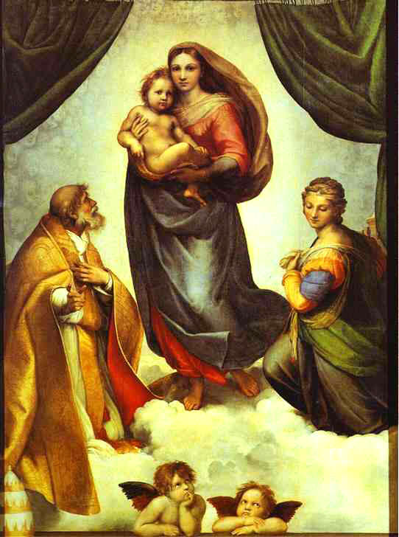
Raphael
He combined religious
art with Renaissance
spirit.
He became famous
for his Madonnas
(Madonnas are images
of the Virgina Mary)

Slide 40
Michelangelo
He was a painter, poet, architect, and a highly skilled sculptor.
He painted the Sistine Chapel

Slide 41
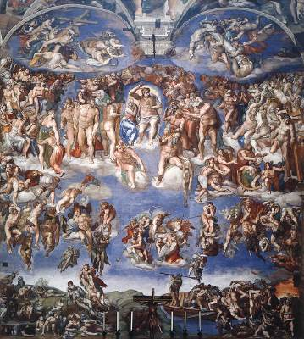
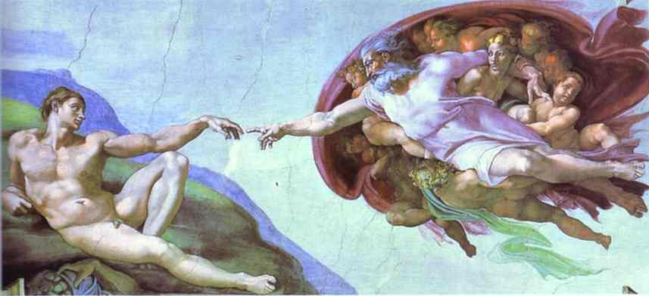
Michelangelo The Sistine Chapel

Slide 42
Leonardo Da Vinci
Known as the “Renaissance Man”, he was a highly skilled painter, engineer, architect, mathematician, scientist, and philosopher.

Slide 43
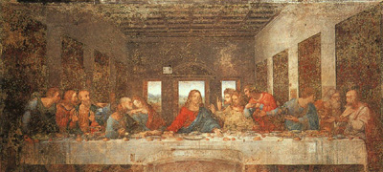
Da Vinci’s The Last Supper

Slide 44
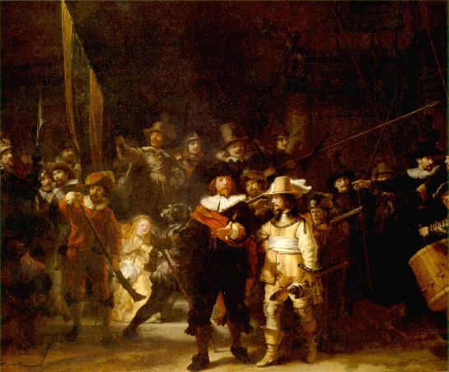
Rembrandt
Northern
Renaissance Man
He painted
realistic scenes
with the use of
light and shade

Slide 45
Stop and Reflect
Which painter do you like the best? Why
In what ways were all 4 painters similar?

