Slide 1
The Reformation
Notes

Slide 2
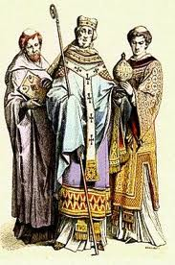
Before the Reformation
The Catholic Church held extreme power
The church had extreme wealth and lots of expensive art
Priests and church officials wore elaborate and expensive clothing

Slide 3
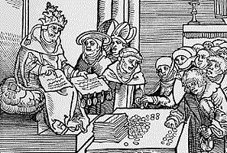
Before the Reformation
The church had developed some interesting practices during this time
Many felt the church had become corrupt
Indulgences- the church allowed people to buy their forgiveness of sins
The church sold leadership positions
The church would charge money to see holy objects

Slide 4
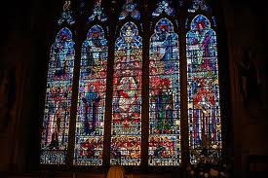
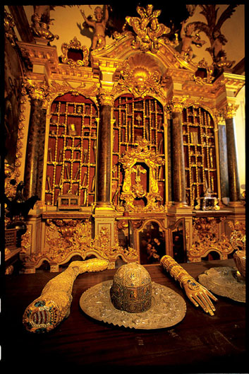
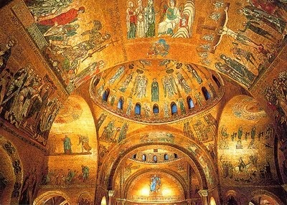
Examples of Church Wealth

Slide 5
Stop and Think
1. What are some problems with the way the church was behaving?
2. Is it ok for the church to make money off its people?

Slide 6
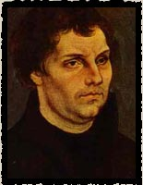
Martin Luther
Martin Luther was a German Monk
Luther began to doubt the church after visiting Rome and seeing corruption in the church
He turned to the Bible to see what it had to say about salvation and the problems of the church

Slide 7
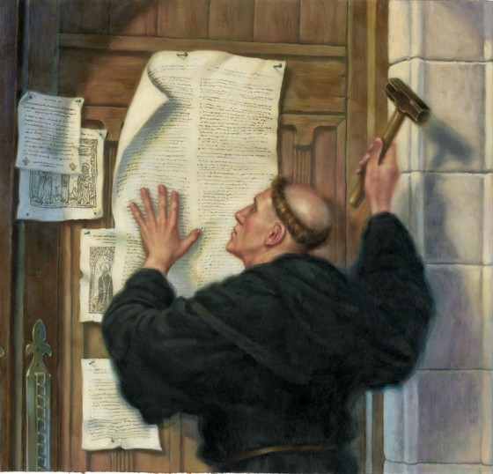
Luther’s 95 Theses
On October 31, 1517 Luther wrote down 95 problems he had with the church
He called them his 95 Theses
He nailed them to the front door of a church in Germany

Slide 8
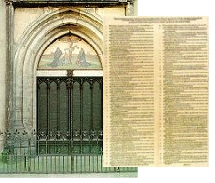

Slide 9
Stop and Think
Make a prediction- What are some problems you think Martin Luther had with the church?

Slide 10
Luther’s Ideas
Some of Martin Luther's beliefs about the Catholic Church:
That people could not 'buy off' their sins by paying money to the Church, only god could pardon sins, not the Church.
That priests should be subject to the law of the land in the same way as ordinary men and women.
That priests were not divine

Slide 11
Luther’s Ideas Continued
That all people should be allowed to read the Bible, not just priests.
The Bible should be written not only in Latin, but in languages that everyone could read
That the Church should not display rich images of Saints and crucifixes and that priests should not wear elaborate clothing

Slide 12
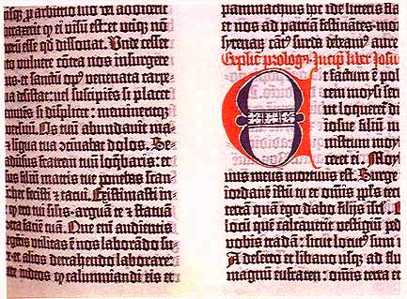
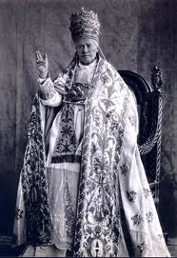

Slide 13
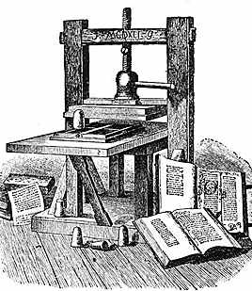
The Impact of the Reformation
The Pope was furious at Luther and had him excommunicated from the church
See how this played out: https://www.youtube.com/watch?v=ijjbtcAEOnY
But some people agreed with Luther’s ideas and they began to be taught
With the help of the newly invented printing press- people were able to have access to Luther’s ideas

Slide 14
Stop and Think
1. How might the spread and impact of Luther’s ideas have been different if the printing press had not been invented?

Slide 15
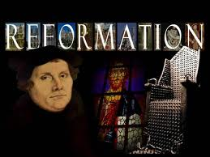
The Impact of the Reformation
People who believed Luther’s ideas became known as Protestants
They started their own church- The Protestant Church
The Catholic Church was no longer the only church

Slide 16
Word Bank for Review Game
Perspective
Renaissance
Medieval Art
Classical Art
Humanism
Reformation
Indulgence
Patron
Rebirth
Petrarch
Da Vinci
Renaissance Man
Protestant
Martin Luther
Renaissance Art
Denomination

Slide 17
