Slide 1
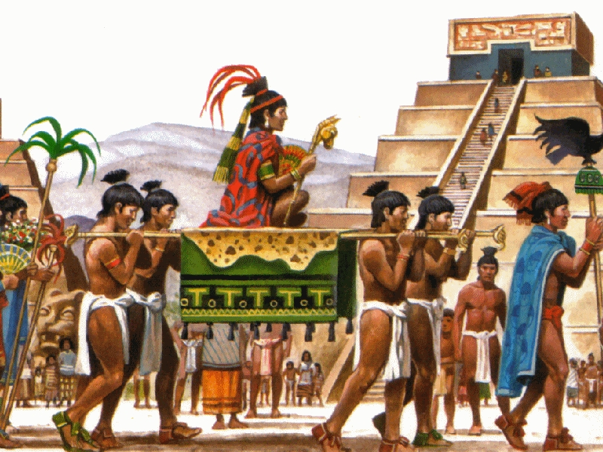
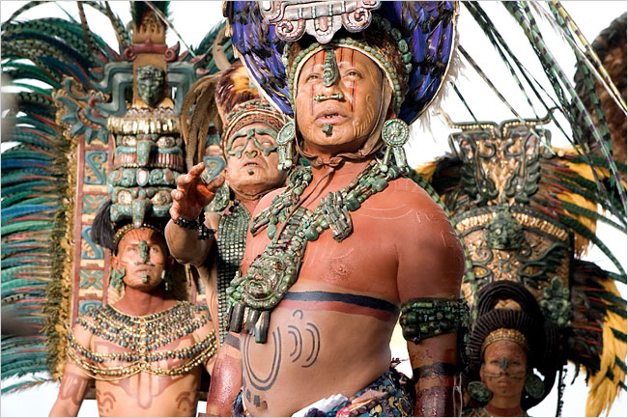
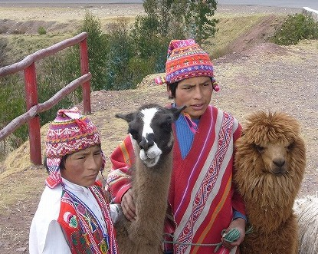
Mesoamerica Notes

Slide 2
What does Mesoamerica mean?
Meso = middle
America = North and South America
STOP AND JOT
What does Mesoamerica mean?

Slide 3
Where is Mesoamerica located?
Mesoamerica is the region that is now Mexico and Central America.

Slide 4
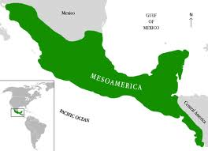
Geography of The Americas
North America
MEXICO
Central America
PERU
South America

Slide 5
Geography of the Americas
On your map, label the following locations:
North America
South America
Mexico
Central America
Peru
Draw a circle around Mesoamerica

Slide 6
Who were the Maya?
The Maya were a people that lived in present day Mexico.
They flourished from 300 AD- 900 AD
The Maya did not have an empire, they lived in a series of city-states

Slide 7
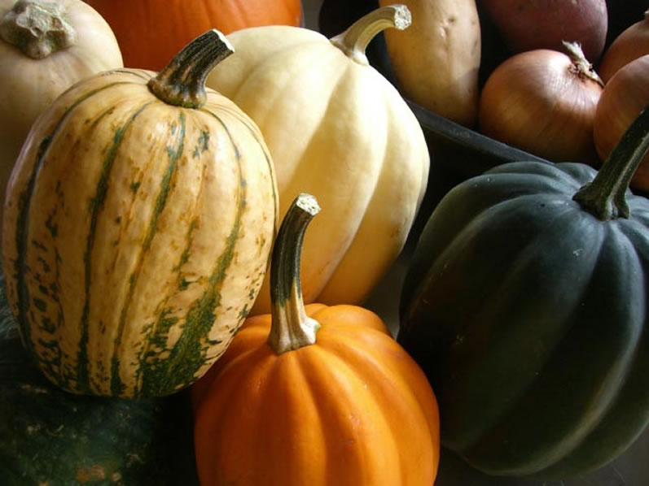
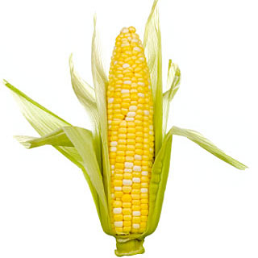
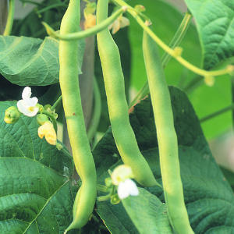
How did they farm?
Mayan farming methods were very advanced
Slash and burn farming— Maya cut down the plants in the rainforest, burned them and used the resulting field to plant in. They used the ashes as soil nutrition
The Mayan’s complex farming system produced enough corn or maize, and other crops to support the growing city.
Mayan crops included: Corn, beans, and squash

Slide 8
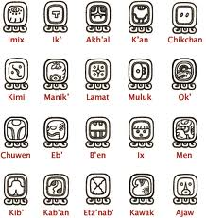
What were Mayan achievements?
The Maya made many advances
Math- Developed the concept of zero
Architecture- Built great pyramids topped with temples to the gods in the capital city of Tikal
Astronomy- Charted the movement of the sun, moon, planets, and stars, and used what they learned to create an accurate 365 day calendar
Writing- Developed a hieroglyphic writing system and kept records

Slide 9
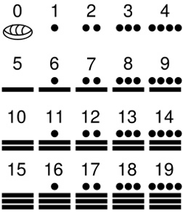
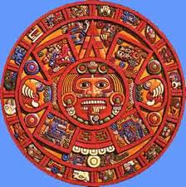
Mayan Calendar

Slide 10
Stop and Jot Mayan numbers
Underneath the table, write these numbers in Mayan math:
7
0
14

Slide 11
Stop and Jot Mayan Math!
Underneath the table, complete the following problems and write the answer in Mayan numbers.
1.
2.
3.
+
=
+
=
-
=

Slide 12
Why did the Maya decline?
The cause of Maya decline is unknown but scholars have theories
Environmental damage due to overuse of natural resources
Warfare over competition for land that destroyed crops
Abuse of power by kings causing rebellions

Slide 13
Stop and Jot
In the table in your notes, jot down at least 3 achievements the Maya made and 2 facts about their decline.
Maya Decline
Mayan Achievements | Mayan Decline
1. 2. 3. | 1. 2.

Slide 14
Stop and Jot
Underneath the table, respond to the following prompt.
Out of the 3 civilizations we have studied so far (Islamic Empire, West African Kingdoms, Maya), which was the most advanced, and why?
Use at least 3 pieces of evidence to support your claim.

Slide 15
Pachacuti video
https://vimeo.com/50650169

Slide 16
Chaitali India | Ta’Nya Nyla | Ymani Victoria
Dontel Ramsey | Kemon Jordan | Rodjane Destiny Wesley
Jasmine Patricia | Amiya Kelvin | Jack Taylor
Khameron Jaquia | Ezra Sacha | Jayquan Kennya
MarQuinn Michael

Slide 17
Miracle Zainab | Kayla Destiny | Lillie David
Jovon Corey | Steven Elijah | Trevon Anthony
Jayden Kahlyl | Derrick Samuel | Cahlyl Tyrell
Dante Tyranae | Jodian Korea
Kevon Naa’Sir

Slide 18
Who were the Aztec?
The Aztec were a people that lived in present-day Mexico from 1350-1519, about 300 years after the Maya.

Slide 19
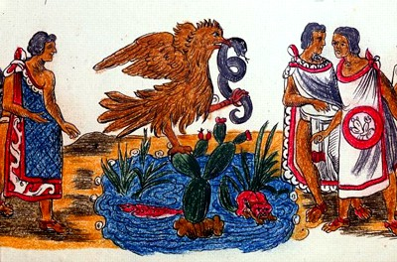
What was the Aztec capital?
The capital city of the Aztecs was Tenochtitlan.
Tenochtitlan was located on an island in Lake Texcoco
According to Aztec legend, the gods had told them to search for an eagle perched atop a cactus holding a snake in its beak.
They finally saw the sign on a swampy land Island, in Lake Texcoco.

Slide 20
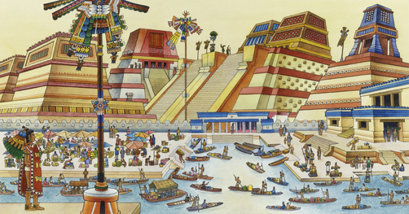
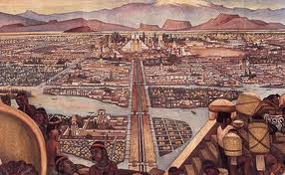

Slide 21
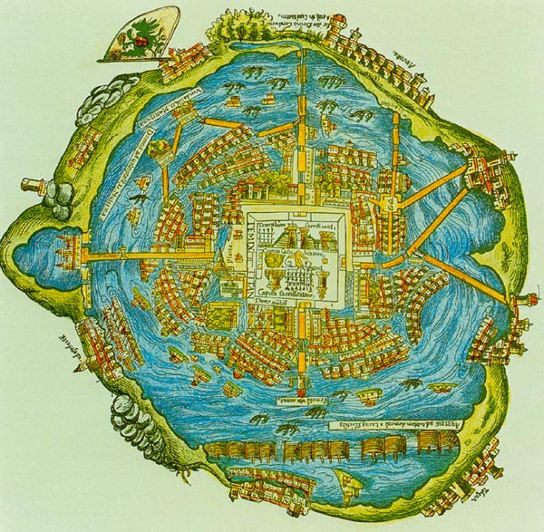
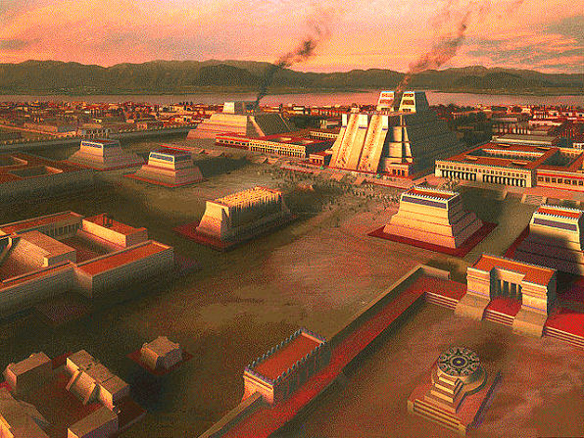

Slide 22
A visitor describes seeing Tenochtitlan
And when we saw all those cities and villages built in the water, and other great towns on dry land, and that straight and level causeway leading to Tenochtitlán, we were astounded. These great towns and temples and buildings rising from the water, all made of stone, seemed like an enchanted vision. Indeed, some of our soldiers asked whether it was not all a dream. It was all so wonderful that I do not know how to describe this first glimpse of things never heard of, seen or dreamed of before. . . .

