Slide 1
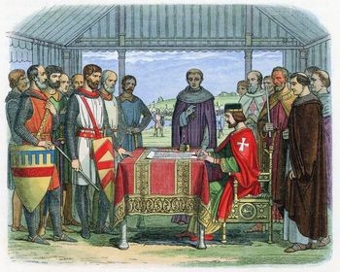
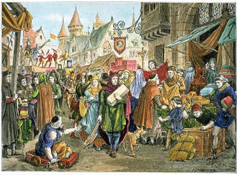

Slide 2
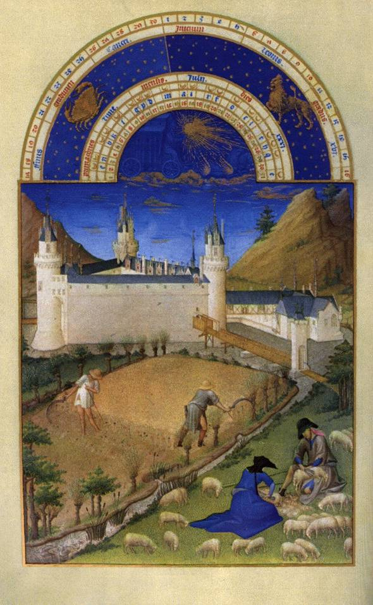
Medieval Europe

Slide 3
Medieval times
As Roman Civilization declined, Europe became an isolated land of disunity, conflict and poverty.
People no longer had the Roman Empire to protect them and unite them
Between 400 and 700, Germanic tribes carved Western Europe into small kingdoms.
This signaled the beginning of the Medieval period

Slide 4
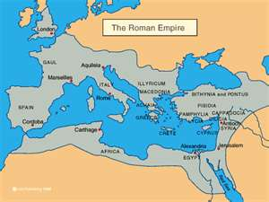
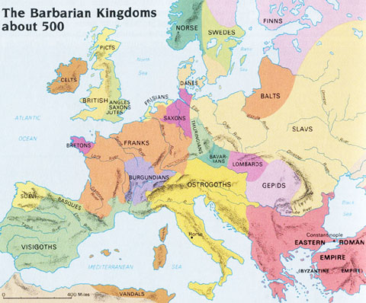
Europe before and after the fall of Rome
Before
After

Slide 5
Feudalism in Medieval Times

Slide 6
Feudalism
In Medieval Times, people lived difficult lives
It took a lot of work to simply survive
A political system called Feudalism was created to solve these issues

Slide 7
Stop and Think
Imagine a time before you could go to the store on the corner to buy the things you need to live. What types of activities would people in Medieval times need to do for themselves in order to be able to survive?

Slide 8
Feudalism
Feudalism is:
A system where people pledge loyalty to a lord or powerful land holder and in return receive land and protection

Slide 9
Feudalism Continued
In Feudal society, people had distinct roles that they played
At the top was the King
Underneath the King were his nobles who he gave land to
Nobles allowed knights, peasants, and serfs to live on their land in exchange for their loyalty to the Noble
During the Middle Ages, people were born into a social class. They had the same social position, and often the same job, as their parents.

Slide 10
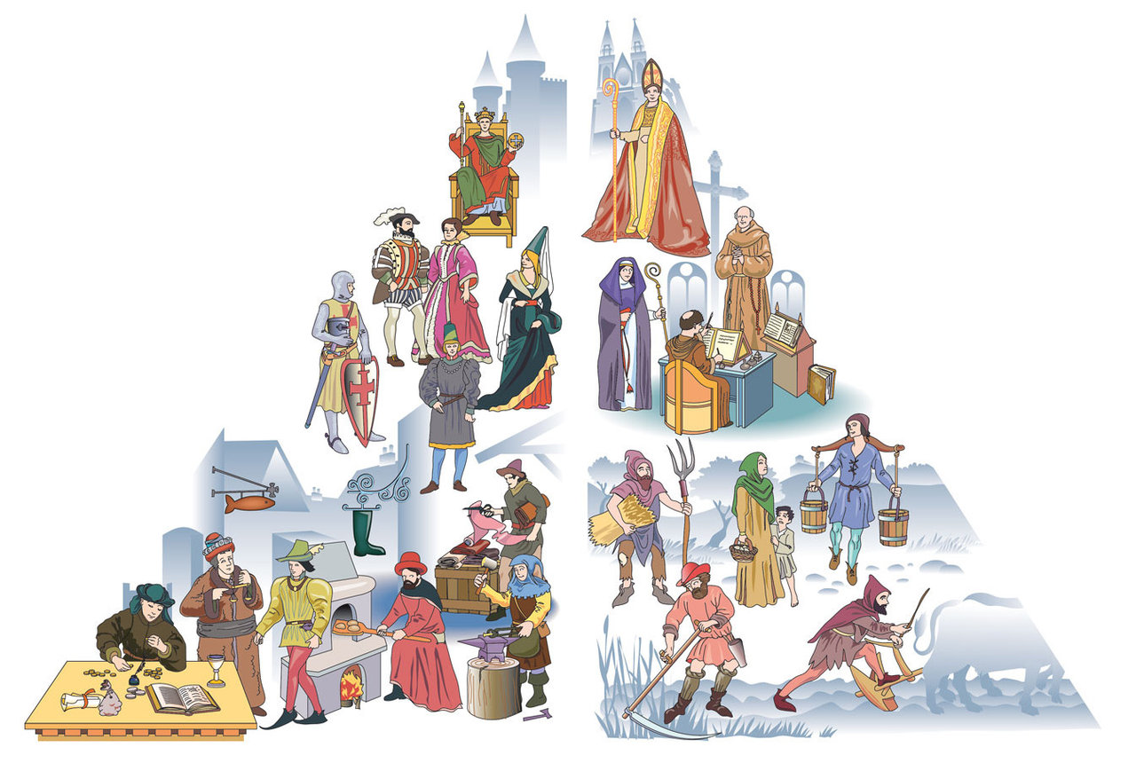

Slide 11
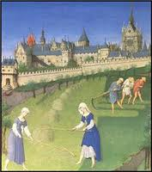
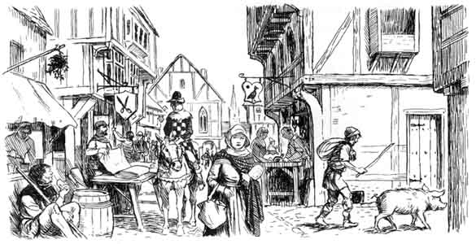
Roles in Medieval Society
The feudal system made sure each person played a distinct role for society to function.
Without any one person in the system, the society would fail

Slide 12
Roles in Medieval Society
King: The ruler of the land and the one who was in charge of making decisions
Lord and Ladies- The noble men, or wealthy land owners who were given manors from the King. Ladies were their wives and daughters
Knights- the sworn protectors of the King and Lords
Peasants- worked the land
Serfs- Peasants who were not free to leave the land

Slide 13
Stop and Think
What other country did we learn about that had a feudal system?
How was that system alike or different than the one in Europe?

Slide 14
Feudal Scavenger Hunt
You travel in time to a Medieval Kingdom. You have never been here before and you are excited to meet as many different people as you can.
When instructed open up the slip of paper and learn about who you are
On the scavenger hunt page, fill in your role on the lines that are about you
Move around the room and meet everyone else, fill in their role on the scavenger hunt paper
Do NOT just say what number you are

Slide 15
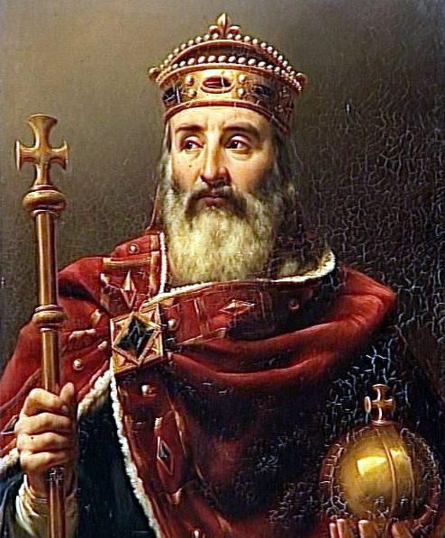
The Age of Charlemagne

Slide 16
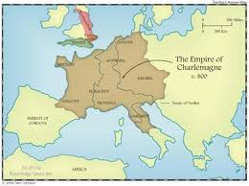
Charlemagne
Around 800, Western Europe was united when an emperor built a vast empire
The Emperor is known in history as Charlemagne, or Charles the Great.
He loved battle and conquered a lot of land, which reunited much of the old Roman Empire.

Slide 17
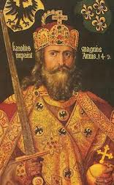
Charlemagne Continued
Charlemagne did many things to exercise control over his many lands and create a United Christian Europe.
He worked very closely with the church; he helped spread Christianity to conquered peoples.
He appointed powerful nobles to rule local regions.

Slide 18
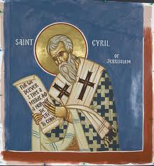
Charlemagne Continued
Education had declined so much that even the clergy (members of the church) were sadly ignorant and uneducated.
Charlemagne himself could read, but not write.
He felt nobles and clergy needed to keep accurate records and write clear reports.
He founded a school and created a curriculum or formal course of study.

Slide 19
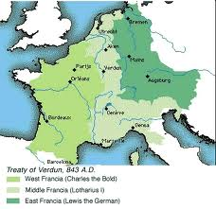
Charlemagne Continued
Charlemagne’s legacy is that he spread Christianity to various parts of Europe

Slide 20
Stop and Think
What were 3 big accomplishments of Charlemagne?
How do you think Europe would have been different without his rule?

Slide 21
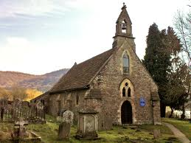
The Church in Medieval Times

Slide 22
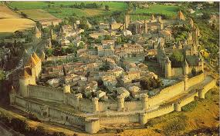
The Role of the Church
The church was the center of medieval life
Every town and manor had a church or cathedral
The church was a daily presence in people’s lives
People even measured how long to cook an egg based on how many prayers they said

Slide 23
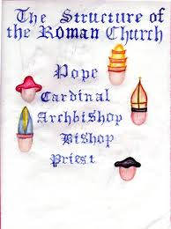
The Role of the Church
Just like feudal society, the church had a very strict structure
Pope
Archbishop
Bishops
Priests
Monks and Nuns

Slide 24
The Role of the Church
The church had incredible power
The only common language in Europe was Latin- The language of the church
Only church officials could read and write
The church could excommunicate people which meant throwing them out of the church
The church taught that the only way to salvation was through the sacraments

Slide 25
Stop and Think
Can you see any problems with the church having so much power?

Slide 26
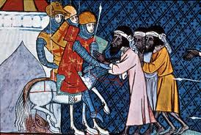
The Crusades

Slide 27
The Holy Land
During the Middle Ages, Christians called Palestine/Israel the “Holy Land” because Jesus had lived there
Many Christians wanted to see the places that Jesus had visited
The Holy Land had been under Christian control, but was retaken by the Muslims who were living there
They soon began preventing Christians from visiting
Rumors spread around Europe that Muslims were killing Christians and destroying Churches

Slide 28
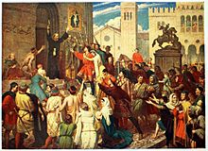
Pope Urban’s Call
In 1095, Pope Urban II called on all European Christians to join together to unite and fight the holy Crusades or wars against the Muslims
The Pope wanted to take the Holy Land back from the Muslims

Slide 29
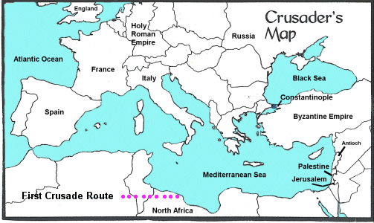
The Crusades
Many European Christians made the long journey from Europe to the holy land to defeat the Muslims
There were seven crusades in total

Slide 30
Stop and Think
On your map, circle the holy land.
Then, trace the route from England to the Holy Land.
List some difficulties a crusader might face on making the journey.

Slide 31
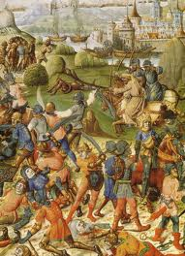
The Crusades
Reasons people went on Crusades
To seek wealth
To guarantee their salvation
Deep religious beliefs

Slide 32
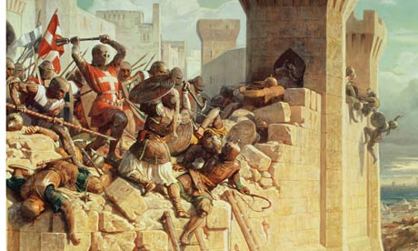
Impact of the Crusades
It is estimated that almost 1.7 million people died on the crusades
This includes Christian crusaders and Muslims, as well as Jews who were massacred during the holy wars

Slide 33
Impact of the Crusades on Europe
Ended Feudalism: Kings grew more powerful as knights, nobles, and serfs left to fight which helped to eventually end feudalism
Advanced civilization: Europeans brought back new inventions and ideas such as algebra, the compass, and medicine
Increase in trade: Merchants became wealthy from trade with Muslims and new economic systems like banks and taxes developed

Slide 34
Effects of the Crusades on Muslims
Since most of Crusades were fought on Muslim land, they faced mass destruction and large death-tolls
There was a smaller long-term impact on the Muslims because Muslim society was much more advanced at the time
Learned about new weapons and military ideas
Merchants became wealthy because of trade with Europeans
Muslims became united against common enemy

Slide 35
Stop and Think
Which group “won” the crusades?

