Slide 1
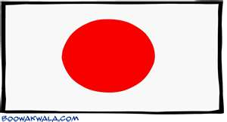
Japan in the Middle Ages

Slide 2
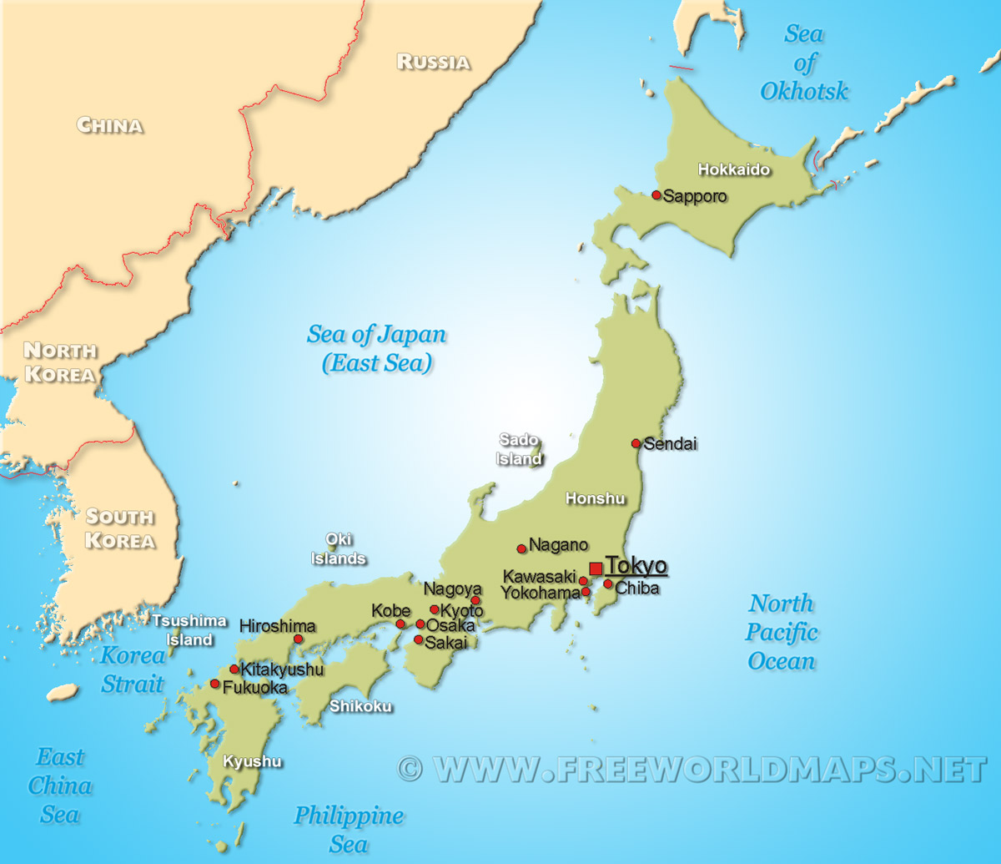

Slide 3
Geography of Japan
Japan is located on an archipelago or chain of Islands about 100 miles off the Asian mainland and east of the Korean Peninsula.
The surrounding seas have both protected and isolated Japan

Slide 4
Stop and Think
How would Japan’s location as an island affect their ability to trade and interact with other countries in the Middle Ages?

Slide 5
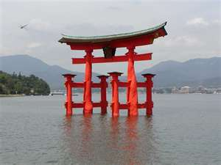
Shinto
This is the worship of the forces of nature or nature spirits known as “kami”
Shinto means “the way of the Gods”

Slide 6
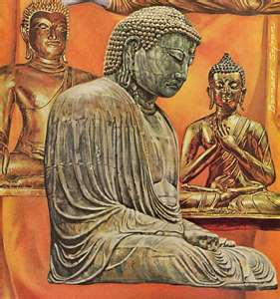
Buddhism
Began in India by a man named Siddhartha
It was brought to Japan from China
Samurai warriors were attracted to Buddhism because it emphasized mediation and devotion to duty.
Buddhism is a religion that believes that life is full of suffering
You should follow the eightfold path to reach Nirvana or happiness

Slide 7
Video
https://www.youtube.com/watch?v=mWRSjieo0CY

Slide 8
Cultural Borrowing
The Japanese borrowed many cultural traits from China
Rich Japanese spoke Chinese and dressed in Chinese fashion
Their cooks also served Chinese dishes and served food on Chinese style dishes
Tea drinking and tea ceremonies were borrowed from China.
Japanese official and scholars wrote history with Chinese characters.

Slide 9
Stop and Think
What would be one positive and one negative effect of culture borrowing?

Slide 10
Heian Period
This was the time period from 794-1185
It was a time when Japan created its own culture
Rich men and women lived in beautiful pavilions and garden courts
Rules of etiquette and manners were stressed.
Beauty and elegance were very important.

Slide 11
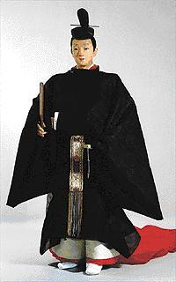
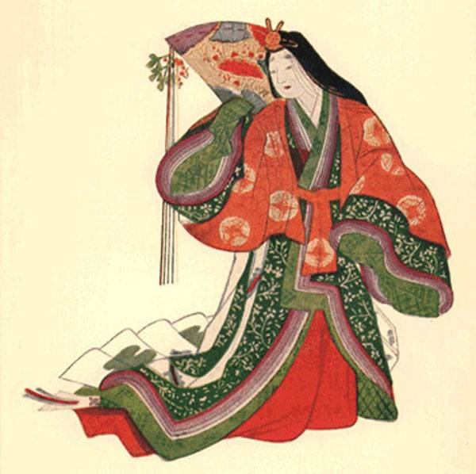
Heian Court Dress
Notes:
What does the clothes tell us about what was important during this time period?

Slide 12
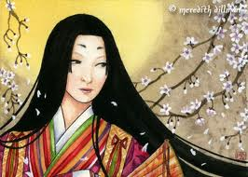
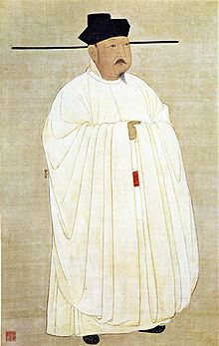
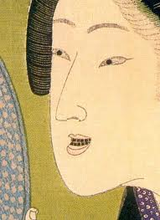
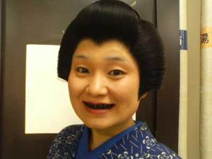
Strange Beauty Tricks of the Heian
Blackened teeth using dyes
Chalky-white faces
with eyebrows painted high on
foreheads
Pointed beards

Slide 13
You Do NOT need to write this down
This system of beauty was meant to attract good matches for women
Finding a good husband was the best way a woman could bring honor to her family
This was depicted well in the Disney Movie Mulan
Clip: http://www.youtube.com/watch?v=soIbKrq7LWM

Slide 14
Feudalism in Japan
_____________________________________________________________________________________________________________________________________________________________________________________________________________________________________________________________________________________________________________________________________________
Feudalism is a political and military system in which you exchange land for loyalty and protection.
In the 1100s, a feudal system developed in Japan
Emperor
Shogun and Daimyo
Samurai
Peasants
Merchants

Slide 15
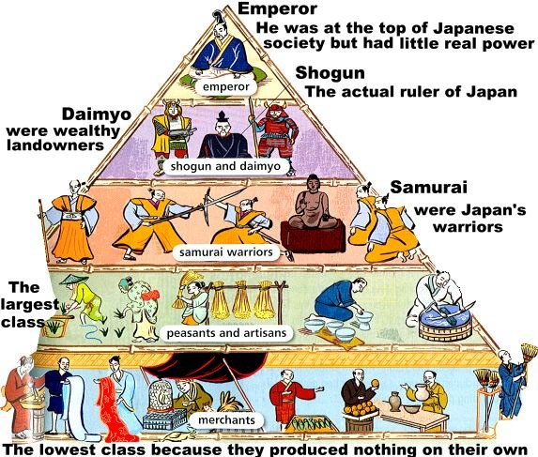
Feudal Society

Slide 16
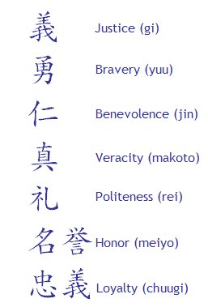
Samurai’s Code of Bushido

