Slide 1
Islam Notes Part1
Objectives:
Students Will Be Able To:
Describe the basic beliefs of Islam

Slide 2
What is Islam?
A religion
1.9 billion people practice Islam (total population is 7 billion people)
People who practice Islam are called Muslims
Islam means “peace through submission to god”
Islam began in the Arabian Peninsula, after the prophet Muhammad heard messages from god.

Slide 3
Geography of the Region Today
EUROPE
ASIA
AFRICA
Arabian Peninsula

Slide 4
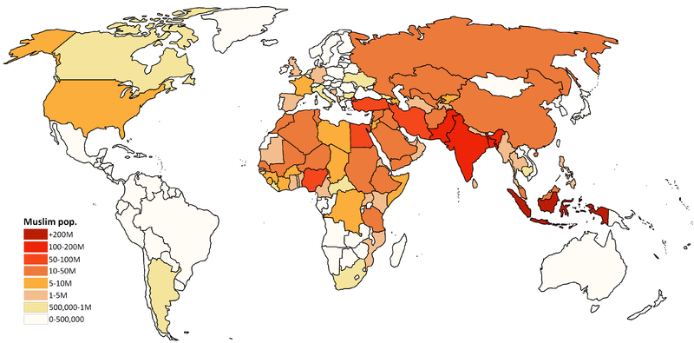
World Islam Population

Slide 5
What do Muslims believe?
Islam is a monotheistic religion. This means that Muslims believe in one god.
Muslims use the Arabic word for god, Allah.
The holy book of Muslims is called the Koran (Qur’an). The Koran includes many stories from the Bible, as well as messages delivered to the prophet Muhammad.
Muslims believe they descended from Abraham’s son Ishmael
Muslims believe Jesus was a prophet, but was not divine, and did not die for their sins.
Muslims believe that Muhammad was the last prophet

Slide 6
What are Muslim practices?
Muslims pray in a mosque.
The most sacred mosque in Islam is called the Kaaba, which is in Mecca.
The holy day of Islam is Friday
The Koran forbids Muslims from eating pork and drinking alcohol
Muslims must fulfill the five pillars of Islam.
Shahada: Testimony of Faith
Salat: Prayer
Zakat: Almsgiving (Charity)
Sawm: Fasting
Hajj: Pilgrimage

Slide 7
Testimony of Faith
Shahada
Faith
Declaration of faith. “There is no god except Allah; Muhammad is the messenger of Allah”

Slide 8
Salat
Prayer
Praying five times a day, facing the holy city of Mecca. Before praying, people must wash their hands and feet.

Slide 9
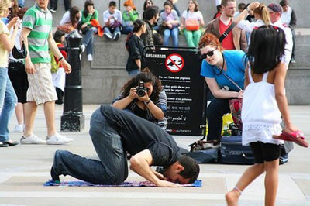
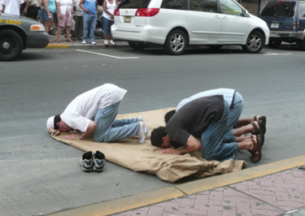
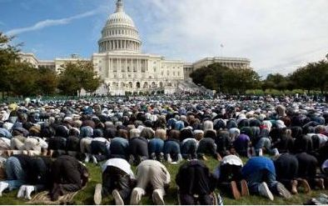
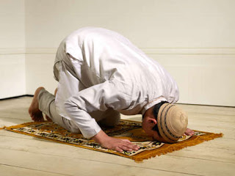
Salat

Slide 10
Zakat
Charity
Giving money (about 2.5% of savings) to charity, perhaps for the poor.

Slide 11
Sawm
Fasting
Muslims must not eat food or drink during the month of Ramadan during daylight hours.

Slide 12
Hajj Pilgrimage
Muslims must make this pilgrimage to Mecca at least once in their lifetime, if they can afford to.

Slide 13
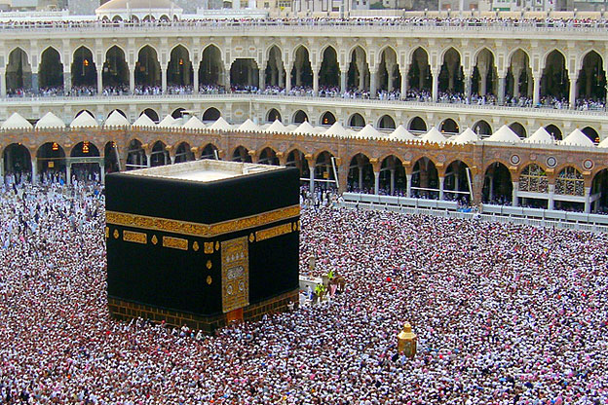

Slide 14
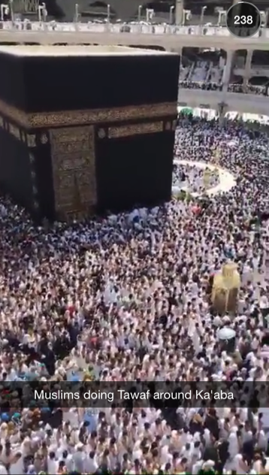
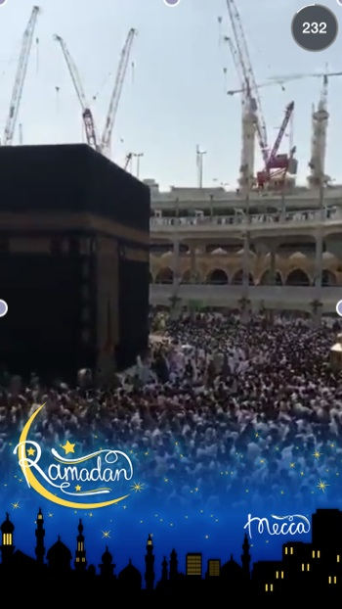

Slide 15
Think, Pair, Share Instructions
Think: Write down your thoughts to the question below
Pair: When Ms. Gamoran gives the instruction, turn to your partner and share your answer
Share: Ms. Gamoran will ask 3 people to share their answer out loud to the class. No one else should speak when their classmates are sharing. Listen to your classmates, and add to your own answer on your notes.

Slide 16
Think, Pair, Share Question
How do the five pillars shape the daily lives of Muslims?

Slide 17
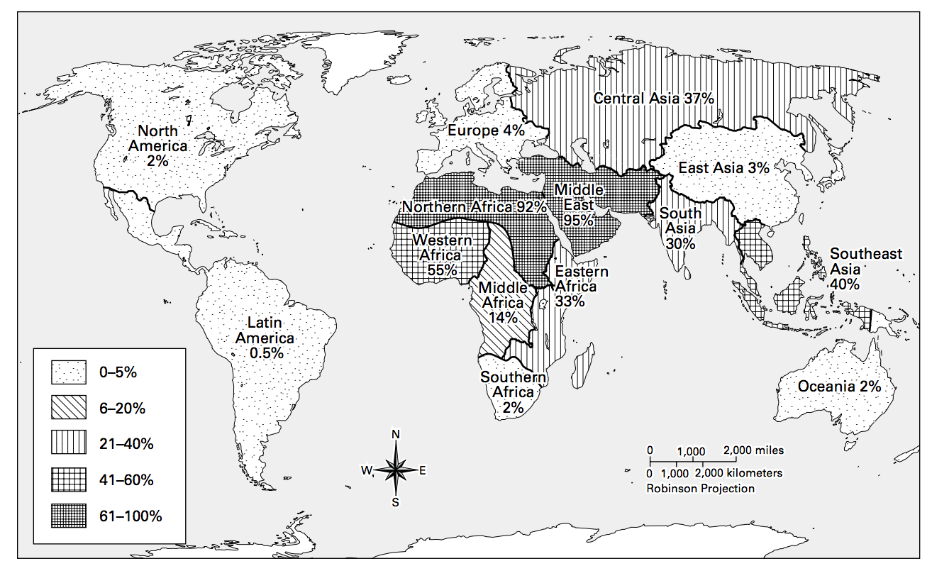
Intro to Islam
World Muslim Population Map

Slide 18
World Muslim Population Questions
1. Which pattern on the map represents the highest concentrations of Muslims? The lowest?
2. In what regions of the world do the most Muslims live? The fewest?
3. Based on this map, in what region of the world do you think the Islamic faith may have originated? Why?

Slide 19
Islam Notes Part 2
Objectives

Slide 20
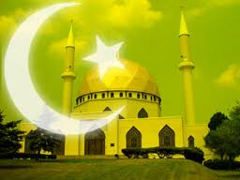
What happened after Muhammad died?
After the death of Muhammad, Islam faced a crisis
Muhammad had no sons to lead after him, and did not leave instructions on how to choose next caliph, or leader of Islam
Muslims split into two denominations, or groups because they disagreed on how to choose a leader.
Sunni
Shia

Slide 21
What did Sunni Muslims want?
The Sunni believed that the next caliph of Islam should be elected by the Muslims
This person would be the person most qualified for the job
Sunni Muslims wanted Abu Bakr, one of Muhammad’s closest advisors to be the next caliph

Slide 22
What did Shia Muslims want?
The Shia believed that the next caliph of Islam should be someone related to Muhammad
It was a normal custom at the time to pass down leadership through male family members
They wanted Ali, Muhammad’s son-in-law to become the next caliph.

Slide 23
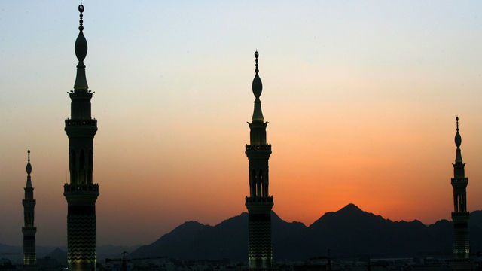
What happened between the Sunni and Shia?
Fighting continues between the Sunni and Shia even today.
By the mid 600s, the Sunni, who were larger in number, had control, and Islam had an elected caliph
Despite violence between the two denominations, throughout this time, Islam began to spread quickly through Europe, Africa, and Asia.

Slide 24
THINK, PAIR, SHARE
Why do you think a disagreement over who should be leader caused such a large split?
Can you think of another example where a minor difference in opinion caused a large split in a group or religion?

Slide 25
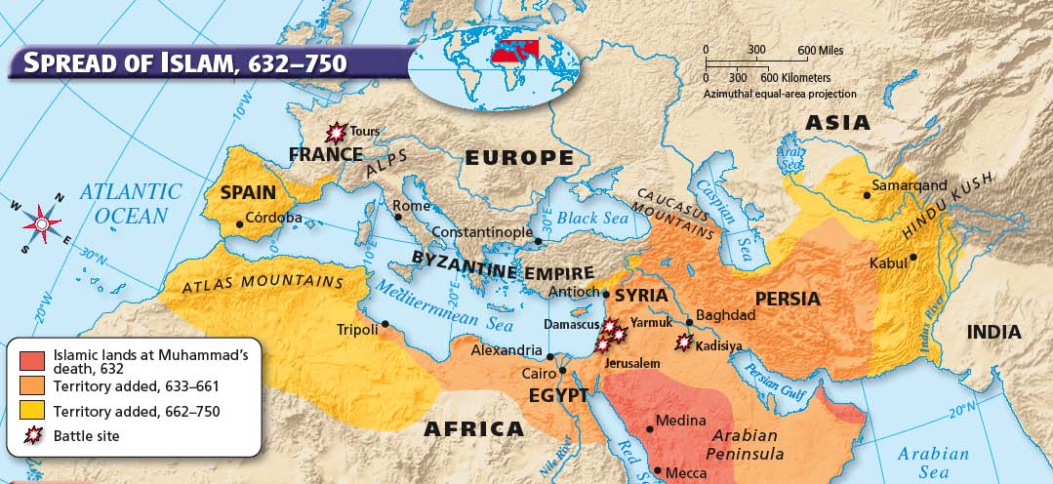
Why did Islam spread so quickly?

Slide 26
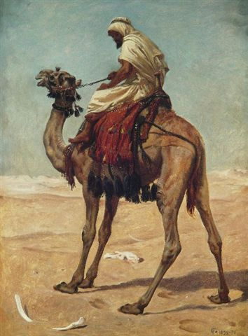
Why did Islam spread so quickly?
Life in the desert was harsh.
People lived nomadic lives, they travelled from place to place in search of food and water.
People stopped at town centers to trade.

Slide 27
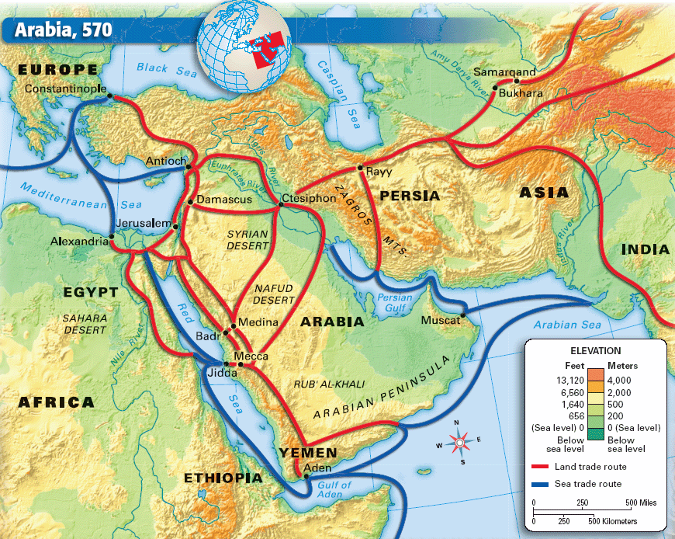
Why did Islam spread so quickly?
Notes:
Mention Mecca, Port cities, Trade routes

Slide 28
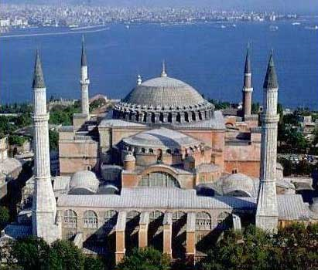
Why did Islam spread so quickly?
The caliphs wanted to spread their empire both politically and religiously
They used military force and often faced weak empires
To many Muslims, this signaled Allah’s support for Islam, and they were able to gain support of conquered people
Notes:
Arabian Peninsula, a lot of people not enough resources
Jihad—religious war for Allah

Slide 29
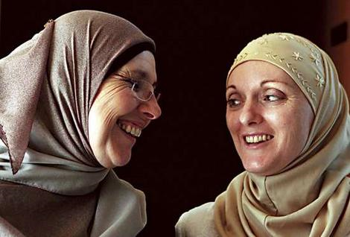
Why did Islam spread so quickly?
Islam also appealed to many people.
Basic Beliefs
Equality
Rights for Women
Social Justice

Slide 30
Why did Islam spread so quickly?
Some people were forced to convert to Islam
Others were required to pay taxes if they did not convert
Muslims had good relations with conquered “People of the Book”
Jews and Christians

Slide 31
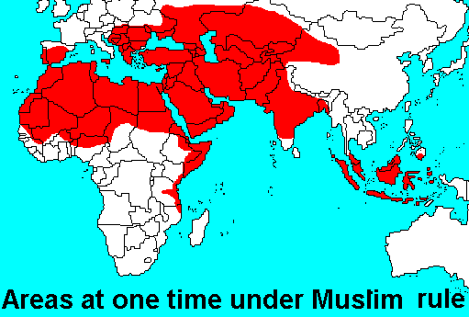
THINK PAIR SHARE
Why do you think Islam was able to spread so far and so fast?

