Slide 1
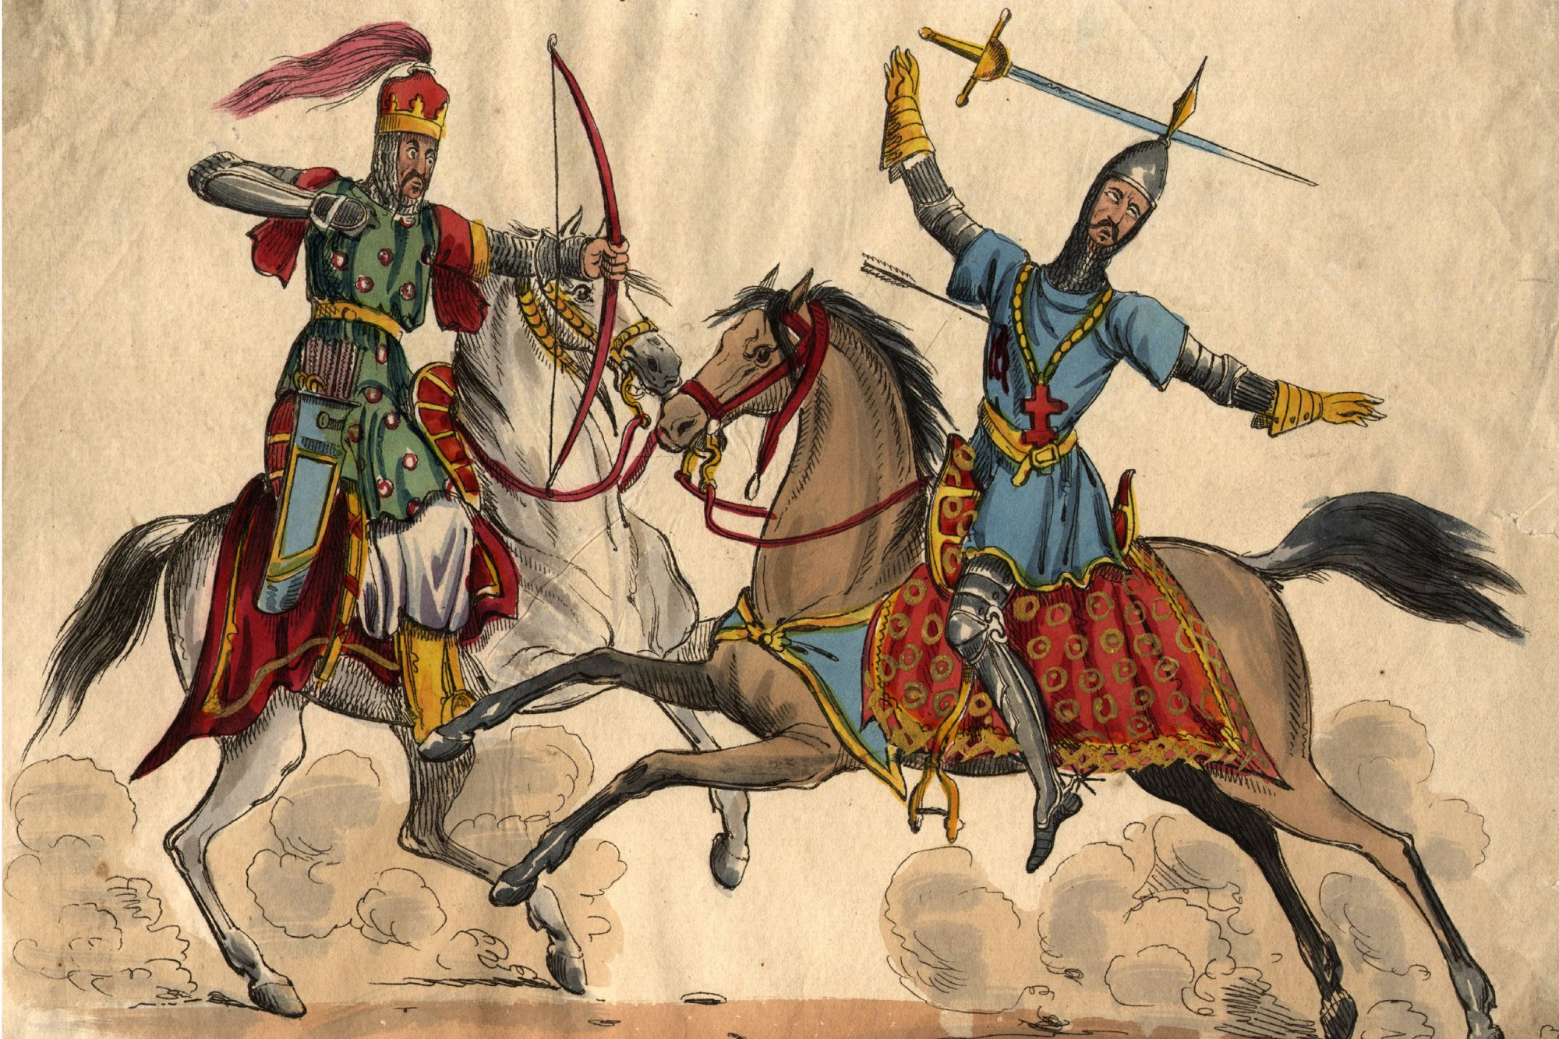
Two Perspectives of the Crusades Close Read

Slide 2
Crusades Reading Instructions
You and your partner should be close enough to easily talk
When I say, “turn and talk” you will share your answer with your partner
When I begin reading again, that means its time to stop talking and listen
All questions will be written on slides for you

Slide 3
Jot Space page set up
1. 2. 3. 4. 5. | 1. 2. 3.

Slide 4
Vocabulary Terms- write a number next to each term and the definition in the margin
1. pagans (line 2): Non-Christian, holding barbaric beliefs
2. remission (line 2): forgiveness
3. omnipotent (line 6): all-powerful, controls everything
4. reproaches (line 7): punishments
5. infidels (line 10): a person who does not believe in religion or follows a religion other than your own
6. mercenaries (line 15): a professional soldier who fights for money

Slide 5
Next Step:
Read the passage to yourself and:
Circle all words Pope Urban uses to describe his enemy

Slide 6
Next Step- Jot 1 lines 1-3
1. The Pope promises what reward to people who die on a Crusade?
Who does he say gives him the authority/power to make this promise?

Slide 7
Jot 2 Lines 4-6
2. Why would the Crusaders be disgraced if they lost?

Slide 8
Jot 3 Lines 6-7
3. What will happen if the Christians do not go on the crusade?

Slide 9
Jot 4 lines 10-16
Pope Urban encourages the Crusaders to change the ways they have been living by listing changes that occur once people go on the crusade- Fill in the chart below:
Before | Now…
Those who were waging private warfare | Fighting against infidels
Those who were Robbers
Those who were fighting against brothers
Those who have been mercenaries

Slide 10
Jot 5 Lines 19-22
How should Crusaders prepare for their journey?

Slide 11
Next Step: Independent Reading
Jot 1: After reading through the text, if you had to sum up the tone of Pope Urbans speech in one word what would it be. Why would you use this word?

Slide 12
Jot 2
2. Throughout his speech, Pope Urbans makes many promises of rewards for those who go on Crusades- List as many of these “rewards” that you can find.

Slide 13
Jot 3
3. Pope Urban uses several types of persuasion to convince people to go on the Crusades, identify at least two methods Pope Urban uses to convince people to go.

Slide 14
Final Thoughts
Would you go on the Crusades? Yes or No

Slide 15
Close Read Part 2- Abu I-Musaffar al Abiwadi Poem

Slide 16
Crusades Reading Instructions
You and your partner should be close enough to easily talk
When I say, “turn and talk” you will share your answer with your partner
When I begin reading again, that means its time to stop talking and listen
All questions will be written on slides for you

Slide 17
Jot Space page set up
1. 2. 3. 4. 5. 6. | 1. 2. 3. 4.

Slide 18
Vocabulary Terms- write a number next to each term and the definition in the margin
1. embers (line 2)- ashes
2. ignominy (line 8)- embarrassment and humiliation
3. lances (line 13)- swords
4. infidels (line 14)- a person who does not believe in religion or follows a religion other than your own
5. sheathed (line 15)- to put a weapon into a case or covering
6. feeble (line 19)- weak

Slide 19
Independent Read- Read through the text on your own
Read the passage to yourself and:
Squiggle all the things the bad things that have happened to the author’s people
Circle all the words that relate to violence

Slide 20
Jot 1 (Lines 1-2)
Why does the author say there is no room for tears and pity anymore?

Slide 21
Jot 2 (8-9)
What does the author say that the Muslims are doing when they should be fighting?

Slide 22
Jot 3 (Lines 8-13)
Underline a line in which the author is attempting to shame the Muslims into fighting. Then, explain how the quote you chose shows that shame.

Slide 23
Jot 4 (Line 14-15)
Who is the author referring to as an infidel? What will the infidels do to the Muslims if they do not begin to fight?

Slide 24
Jot 5 (Line 16-19)
In line 16, the author refers to someone that lies in the tomb at Medina. Who is this person?
In line 19, the author refers to the “feeble pillars.” What are the pillars he is referring to?

Slide 25
Jot 6 (Lines 20-21)
Why are Muslims evading (avoiding) the fight?

Slide 26
Jot 1
Jot 1: After reading through the text, if you had to sum up the tone of Al Abiwardi’s poem in one word what would it be. Why would you use this word?

Slide 27
Next Step: Jot 2
What methods does Al Abiwardi use to convince his audience to fight against the crusaders?

Slide 28
Jot 3 Comparing texts
Put a box around the word infidel in both texts. Why do both authors use this word to describe their enemy? Can both Christians and Muslims be infidels?

Slide 29
Jot 4
Whose speech would convince you more, Pope Urban or Abu l-Musaffar al Abiwardi? Why?

Slide 30
Final Writing Prompt Minor assessment
Select ONE of the following options to respond to. Don’t forget to respond using quote sandwiches!
Use evidence from both Pope Urban’s speech and Al Abiwardi’s poem to prove that both Christians and Muslims felt justified in their fight.
Use evidence from both Pope Urban’s speech and Al Abiwardi’s poem to explain how each author used persuasion to convince their audience of the importance of the Crusades.
Use evidence from both Pope Urban’s speech and Al Abiwardi’s poem to explain how each author saw truth in their mission during the Crusades.

