Slide 1
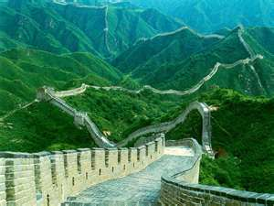
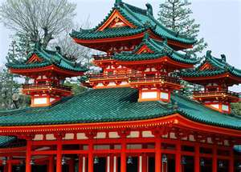
China and Japan in the Middle Ages

Slide 2
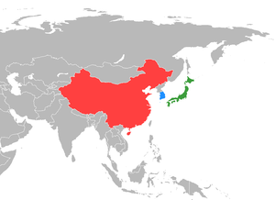
Geography of China and Japan
MONGOLIA
CHINA
JAPAN
East China Sea
PACIFIC OCEAN
INDIAN OCEAN

Slide 3
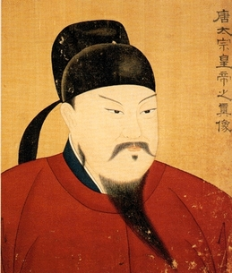
China’s First Emperor
China had a long history of conflict and constant fighting over land
There were many groups that wanted to control China
In 221 BC a new leader finally unified all of China
His name was Qin
He came to power and took the throne at only 13 years of age

Slide 4
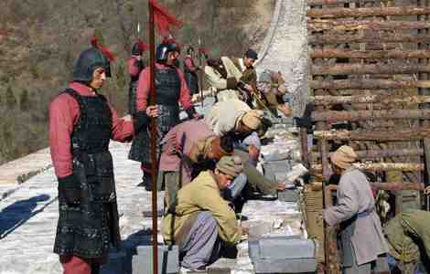
Qin and the Great Wall
China shared a long border with the neighboring country of Mongolia
The Mongolians were fierce warriors and a threat to China’s safety
Qin built the Great Wall to protect China from invaders to the North

Slide 5
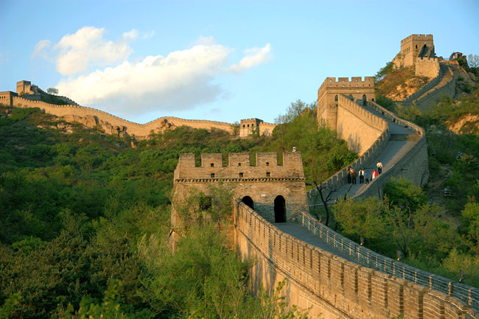
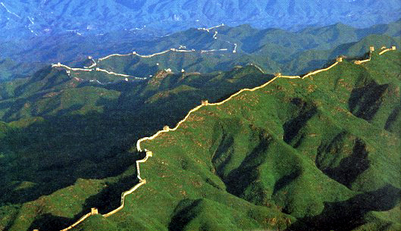

Slide 6
Legends of the Great Wall
The wall took hundreds of years to complete
It is said that thousands of people worked on the wall
Thousands of these people also died while working on the wall and are now buried inside

Slide 7
Legends of the Great wall
Many other Chinese dynasties (family of powerful leaders) added to the Great Wall of China, expanding its length beyond what Emperor Qin had built
The wall was meant to keep out invading armies, as well as small groups of nomads from the North who wished to attack and steal from small villages.
It was successful at scaring the nomads and protected many of China’s small villages.

Slide 8
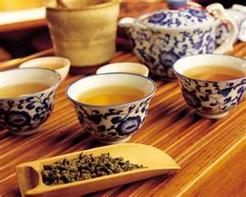
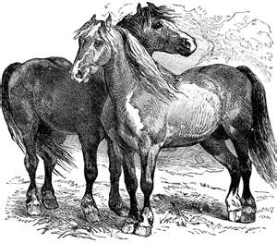
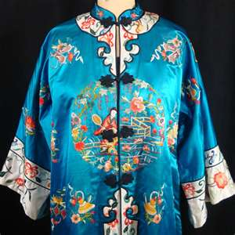
China Notes Part 2

Slide 9
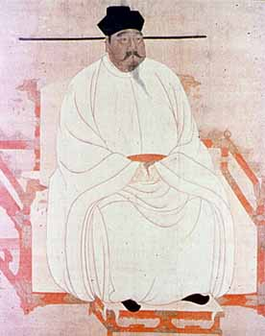
Tang and Song Dynasties
The Tang and Song Dynasties restored culture and prosperity in China
The Tang dynasty lasted for nearly three hundred years, between 618 A.D. and 907 A.D.
Tang rulers created a more stable economy by giving land to the peasants and breaking up large pieces of land to reduce the power of their owners.

Slide 10
Tang and Song Dynasties
The Tang had a highly organized government and employment system called the Civil Service System
In this system, the government allowed anyone, even commoners, to take an exam. A high enough score on the exam meant a government job.
Because of this system, the government became filled with highly qualified and intelligent people.

Slide 11
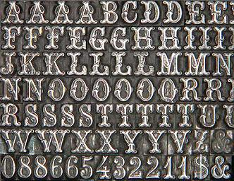
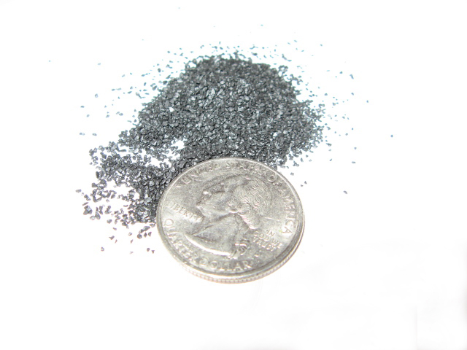
What are these?

Slide 12
Accomplishments of Tang and Song Dynasties
During the Tang and Song Dynasties, the Chinese invented new technology and other items that improved the way they lived and our lives today
Compass
Gunpowder
Block Printing/ Moveable Type

Slide 13
Silk Road
They traded with the West along the Silk Road, a trade Network that connected the East (China) with the West (Europe)
Many goods and ideas were traded across the Silk Road
From the West (Europe) to the East (China) | From the East (China) to the West (Europe)
Furs Perfumes Glass Bronze Weapons Horses Ceramics Christianity and Islam | Tea Compass Block Printing Silk Gun Powder Paper Buddhism

Slide 14
Confucius A Chinese Philosopher

Slide 15
Confucius the Wise
During the Tang and Song dynasty, much of government policy was based on a Chinese philosopher named Confucius
Confucius was born during a time when China was being torn apart.
He believed that if society is orderly and has good leaders things could improve.
His teachings focused on respect for relationships and
education

Slide 16
Confucius the Wise
Confucius believed that society functioned best if everyone respected laws and behaved according to their position in society
Confucius taught that harmony resulted when people accepted their place in society.

Slide 17
5 Relationships
Confucius stressed 5 relationships
1. Ruler and Subject
2. Parent and Child
3. Husband and Wife
4. Older brother and younger brother
5. Friend and friend
The only equal relationship was friend to friend

Slide 18
Government Role
Confucius also taught that it was a ruler’s responsibility to provide good government.
In return, the people would be respectful and loyal subjects.
Confucius said the best ruler was a virtuous one who led people by good example.
Confucius believed that government leaders and officials should be well educated.

Slide 19
Stop and Think
The Tang and Song dynasty set up the Service Examination that tested students who wanted to work for the government. Explain how this was modeled after Confucian beliefs.

Slide 20
WWCD
What Would Confucius Do?

Slide 21
You will be shown scenarios on the board. Decide what you think Confucius would tell you to do.

Slide 22
Scenario 1
Kayla is to trying to decide how to vote. One candidate is intelligent and well educated but from a poor family. The other candidate is from a privileged background and a long line of politicians; the candidate has a good education but may not be as talented as the first candidate. For whom would Confucius vote? Why?

Slide 23
Scenario 2
Darius is a successful businessman with a wife and two kids. His parents are getting old and need more care. He considers asking them to move in with him and his family. If Confucius were in the same situation as Darius, what do you think he would do? Why?

Slide 24
Scenario 3
Amanda has a chance to make some money on an idea that her friend shared with her. She could either tell everyone that it was her own idea and make a lot of money, or she could give credit to her friend but lose her chance to make a large profit. What do you think Confucius would tell her to do? Why?

Slide 25
Scenario 4
Mr. Williams, a 27-year-old teacher at DC High School, recently received his master's degree. The head of his department, Mr. Thompson, who is older than Mr. Williams, received his masters many years ago. Mr. Williams is anxious to try some of the new teaching methods he learned in graduate school with his high school students, but Mr. Thompson wants him to stick to the regular methods. What do you think Confucius would tell him to do? Why?

