Slide 1
Ancient Rome Notes

Slide 2
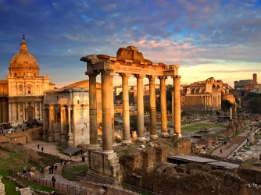
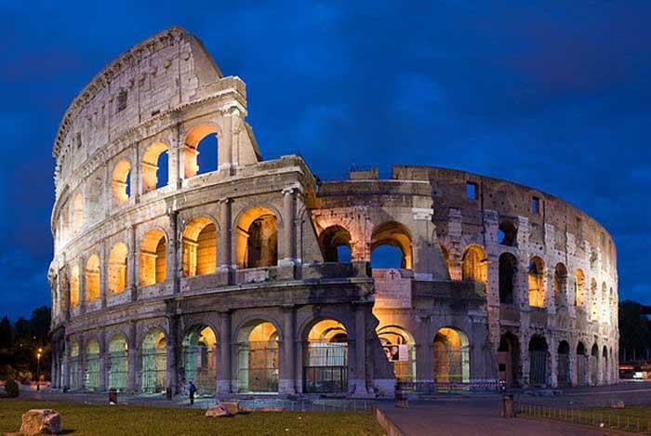
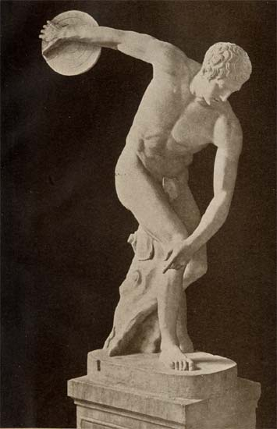
The Importance of Rome
Considered to be the start of Western Civilization
Was one of the first and largest political empires to ever exist in our world
Their laws and language (Latin) was passed on to other civilizations
Was used as the main means of spreading Christianity throughout Europe
Time Frame: 753 BC- Around 400 AD

Slide 3
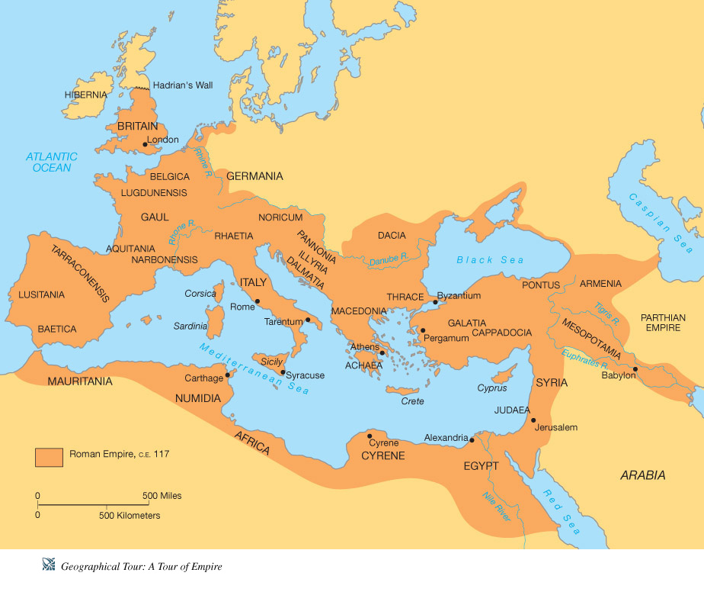

Slide 4
Social Structure
Patricians → rich landowners who inherited their power and social status; held most of the power in Rome
Plebeians →commoners, artisans, and merchants who made up the majority of the population; citizens who could vote, could not hold important government positions
Slaves → captured peoples during the wars; made to work on the latifundia, huge estates; were one-third of the population

Slide 5
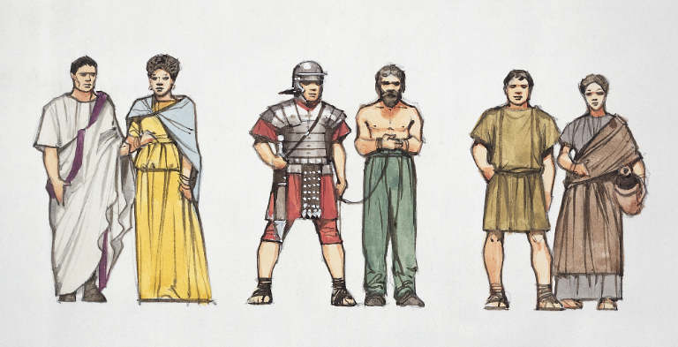
Patricians Slaves Plebeians

Slide 6
Daily Life
Rich - had country estates (villas), enjoyed a high quality of life
Poor- lived in apartment houses, no running water, jobless, lots of fires in Rome, very dirty
Slaves- slaves almost no rights, worked in homes of rich and on farms or in the army
All enjoyed the games at Colosseum (circuses, gladiators, animals)
Family life- strong family values, government rewarded parents who had many children, father had absolute power, women's role depended on wealth

Slide 7
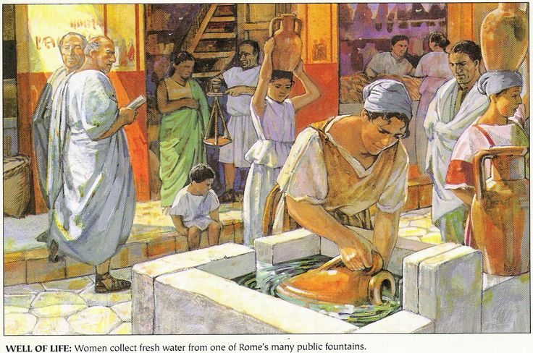
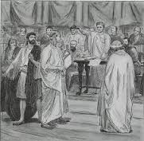
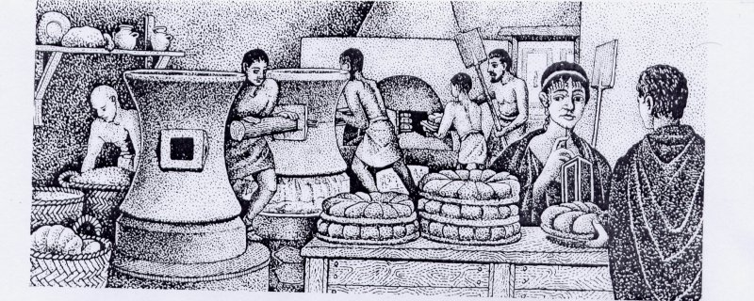

Slide 8
GOVERNMENT
Roman Republic- a system of government in which people can vote on who will rule them. In Rome, there were several types of leaders.
2 Consuls— elected (chosen) by the people through a vote. The consuls oversaw other government officials, directed the army, and acted as judges. The two consuls had to agree in order to take action.
Senate— Were all patricians, chosen by the consuls, were advisors to the consuls, approved laws passed by the Assembly, decided how money should be spent, had influence over the consuls and army
Assembly— Largest branch of government made up of Plebians and Patricians. voted on laws suggested by government officials, could declare war or make peace treaties, elected the 2 Consuls

Slide 9
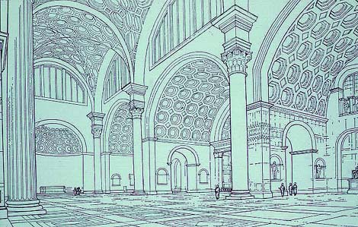
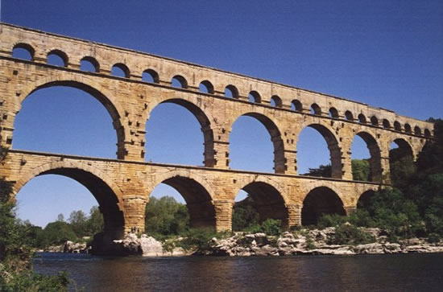
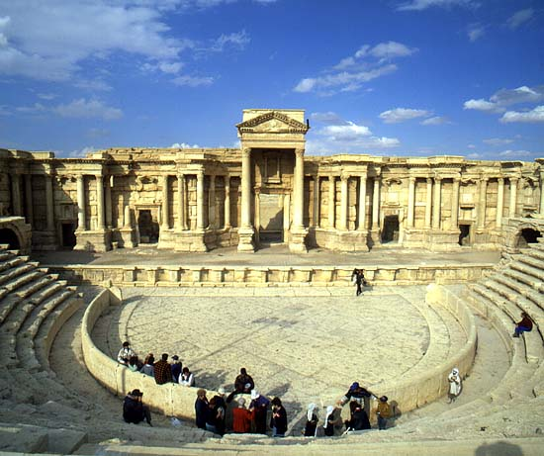
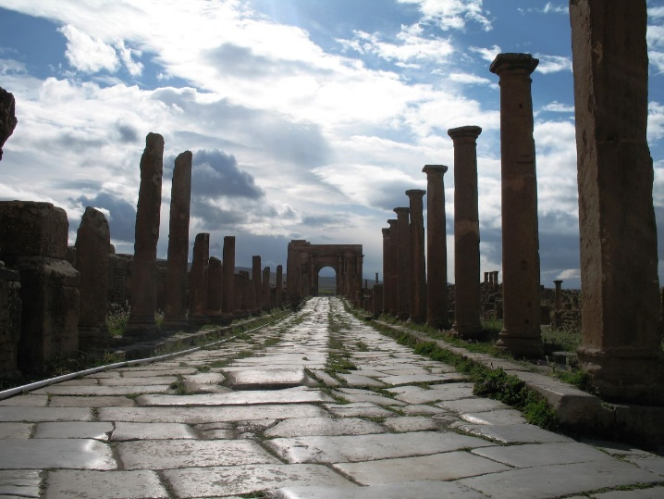
Achievements
Architecture and Technology- used arches and columns, invented concrete
Built Colosseum (50,000 people, used for fighting, and ship battles), Circus Maximus for chariot racing, aqueducts
Roman roads- "All roads lead to Rome"
Roman Law- an early form of the Bill of Rights (Justinian Code), have to face your accusers, "Beyond a shadow of doubt"

Slide 10
Stop and THink
What you do you think about the Romans? How do they compare/contrast with other civilizations we have discussed?

