Slide 1
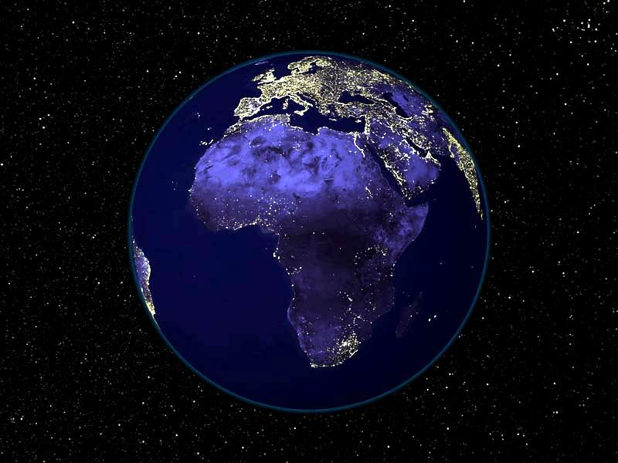
Geography of Africa

Slide 2
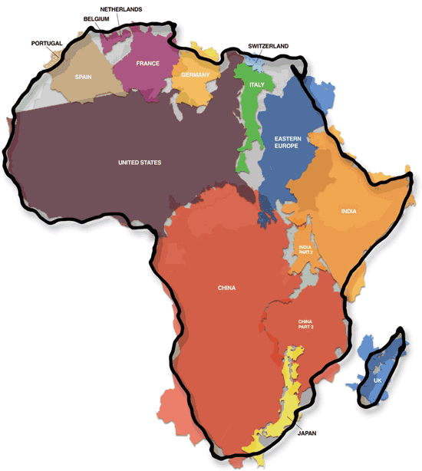

Slide 3
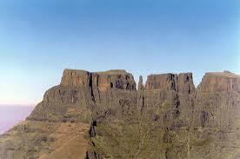
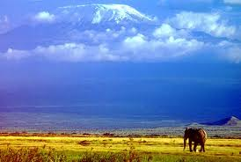
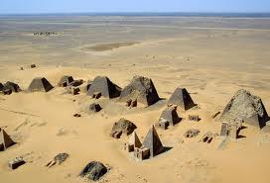
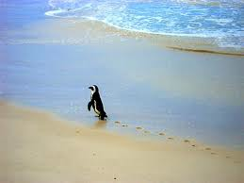
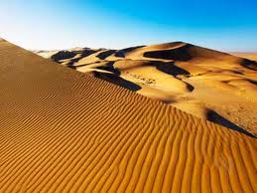
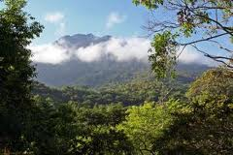
Which of the following images do you think is a landscape in Africa?
C
A
B
D
F
E

Slide 4
Geography of Africa
Africa is a land of many landscapes, from lush rainforests, to tropical savannas, to deserts that stretch for hundreds of miles
There is more to the land of Africa than you think!

Slide 5
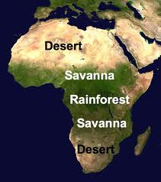
Physical Map of Africa
Africa is the second largest continent
Africa covers 1/5 of all the worlds surface

Slide 6
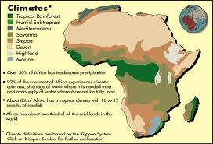
Climate Zones of Africa
The geography of Africa is diverse and has many different types of climates
Major Climates of Africa
Rainforest
Desert
Savanna
Other climate zones
Humid Subtropical
Mediterranean
Highland
Marine

Slide 7
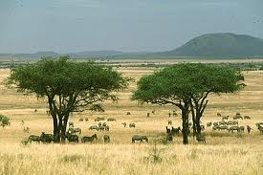
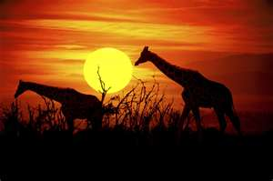
Climate Zones of Africa- Savanna
Africa’s largest and most populated climate zone is the Savanna
The Savanna is a large grassy plain that has good soil which allows people and animals to survive off the land

Slide 8
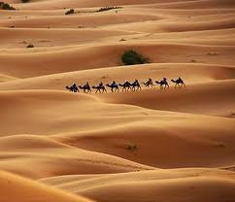
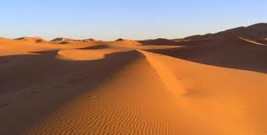
Climate zones of Africa- Desert
The Sahara desert is the world’s largest desert.
It covers most of Northern Africa
The desert made travel and trade difficult for many years for the people in North Africa

Slide 9
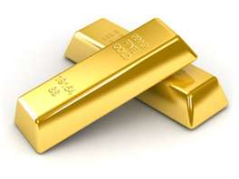
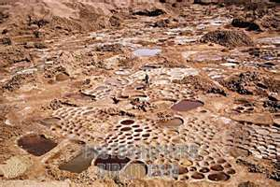
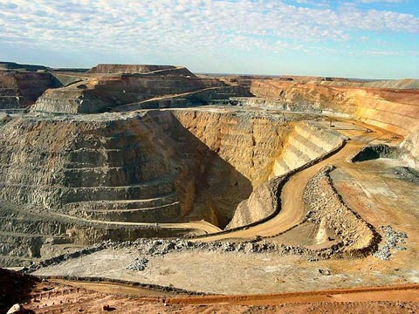
Natural Resources of Africa
Africa is a land full of natural resources
Gold, Salt, Iron and Copper were all valuable to people
Later on in Africa’s history, diamonds and oil will become important resources as well

Slide 10
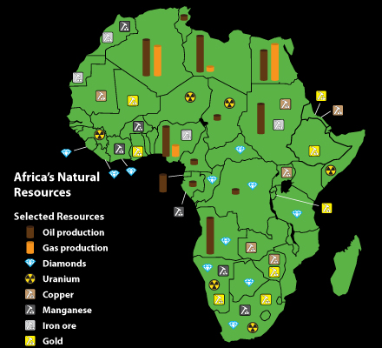

Slide 11
Stop and Think
We just learned that Africa is a land of abundant resources, why do you think so many people have the perception that Africa is poor if it has so many valuable resources?

Slide 12
Geography of Africa in the Middle Ages- Spread of Islam
During the Middle Ages, Arab armies spread Islam into North Africa
Islam replaced Christianity as the dominate religion of North Africa
North Africa benefited from the Muslim civilization and culture
Mosques
Libraries
Trade Network
Muslim traders from North Africa spread Islam into West Africa

Slide 13
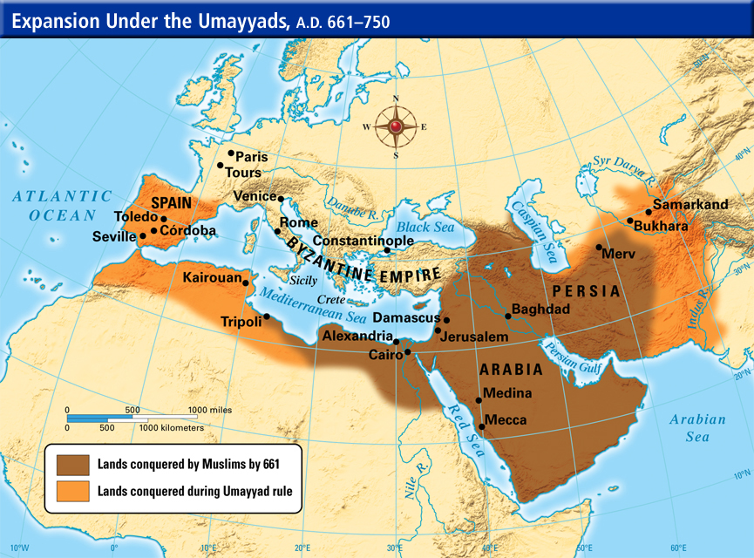

Slide 14
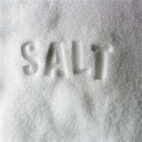
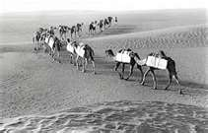
Gold and Salt Trade
There were two main products that dominated Saharan Trade- GOLD and SALT
Salt was needed to prevent dehydration . Some areas had a lot of salt. Many people even built their homes with salt
Yet, in other areas, there was not enough salt- which made it a valuable item for trade

Slide 15
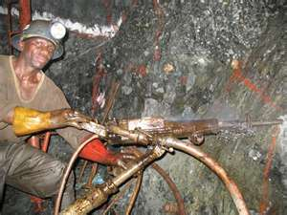
Gold and Salt Trade- Cont.
Gold was another important commodity, or product, which was abundant in West Africa
Men dug up the soil, while women washed the soil to extract the gold. The gold dust was then stuffed into feather quills to safely transport it

Slide 16
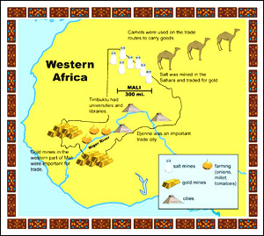
Map of the Gold and Salt Trade

Slide 17
Stop and Think
Which is more valuable in our modern world? Gold or Salt?
How would our world be different if gold was as valuable as salt and they could be traded equally?

Slide 18
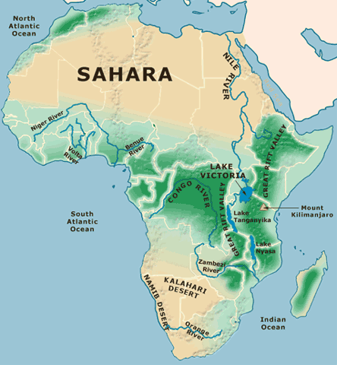

Slide 19
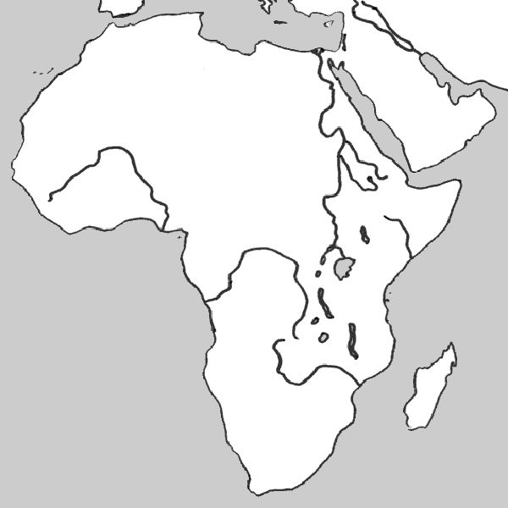
SAHARA
Nile River
Niger River
Great Rift Valley
Congo River
Lake Victoria
Atlantic Ocean
Mt. Kilimanjaro
Zambezi River
KALAHARI
Indian Ocean

Slide 20
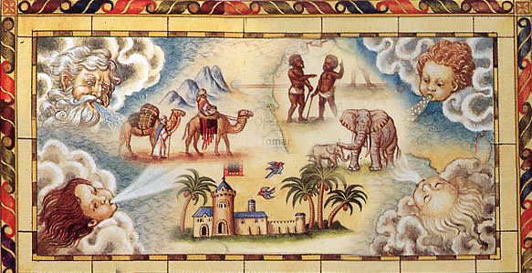
Africa in the Middle Ages
West African Empires

Slide 21
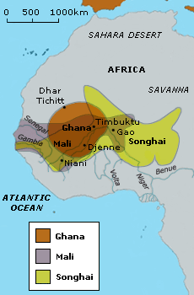
Kingdoms of West Africa
3 kingdoms dominated the Gold and Salt trade during the Middle Ages
These kingdoms were:
Ghana
Mali
Songhai

Slide 22
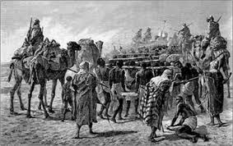
The Gold Wealth of Ghana
This kingdom is locate in what is Southern Mauritania and Western Mali today
Ghana is first mentioned in texts in 830 CE but is believed to have begun much earlier
The rulers of the Soninke people united many farming villages to create the kingdom of Ghana.

Slide 23
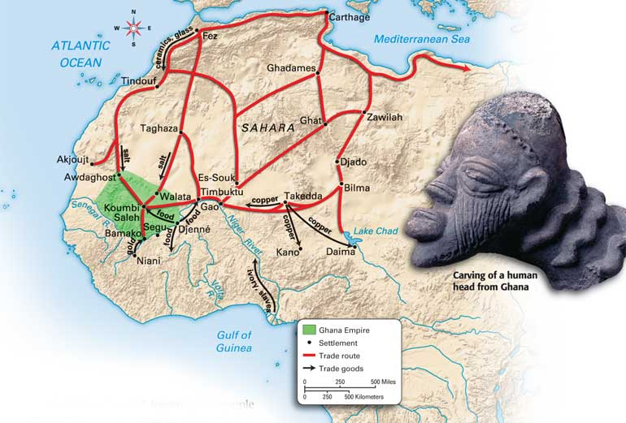
The Gold Wealth of Ghana
Around the 800s, the introduction of the camel as a form of transport changed the kingdom
Now goods could be traded
The extensive gold, salt, and ivory of West Africa was sent North to be traded for manufactured goods

Slide 24
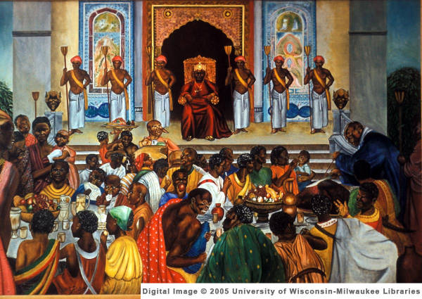
Gold Wealth of Ghana
Ghana grew extremely wealthy because of its trade
Its economy was based mostly on merchants
Ghana developed a system to tax the goods that came through the kingdom

Slide 25
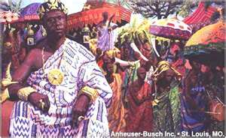
The Gold Wealth of Ghana
Ghana was known as the “land of Gold”
It is said that though the king was a just leader, he hoarded a lot of his wealth
It is said that he kept all the gold nuggets and allowed his people only to have gold dust

Slide 26
Decline of Ghana
Due to a lack of sources, its difficult to know exactly how Ghana began to decline
Probably occurred around 1076 when they were attacked by another empire
The remains of Ghana became a part of the next major trading kingdom- Mali

Slide 27
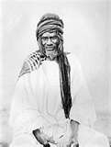
The Kingdom of Mali
After the fall of Ghana, the Mandinka people on the upper Niger suffered a bitter defeat by a rival leader. Their King and all, but one of his sons were executed.

Slide 28
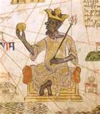
The Kingdom of Mali
The only survivor was Sundiata, who by 1235 had crushed his enemies and founded the Kingdom of Mali.
Mali was an important kingdom from the 1200s-1600s
Mali is an Arab word that means “where the king dwells.”

Slide 29
The Kingdom of Mali
Mali began to control the gold and salt trade
They had three large gold mines within their territory
It became the world’s leading source of gold

Slide 30
Mali under Mansa Musa
The greatest emperor of Mali was Mansa Musa, who took the throne in 1312
Mansa-Musa reigned for 25 years. He worked to ensure peace and order, he expanded Mali’s borders
He converted to Islam and based his system of justice on the Quran.
In 1324, Mansa Musa fulfilled one of the five pillars of Islam by making the hajj, or pilgrimage, to Mecca.

Slide 31
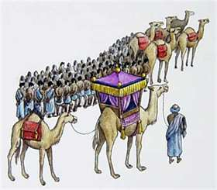
Mali under Mansa Musa
Through his pilgrimage, he showed his devotion to Islam and developed strong economic and political relations with other Muslim states
The Hajj made Mali well known and increased its wealth
Timbuktu became a leading center of learning.

Slide 32
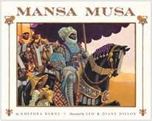
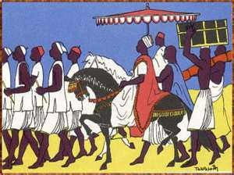
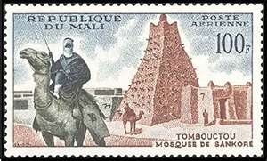
Mansa Musa’s Pilgrimage

Slide 33
Stop and Think
Mansa Musa’s pilgrimage helped to spread Islam throughout the region- how do you think the region would have been different if Mansa Musa hadn’t converted to Islam?

Slide 34
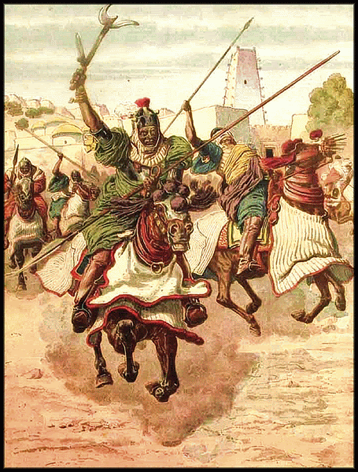
Decline of Mali
Around 1610, an important ruler of Mali died
It is said that his three sons fought over control of the kingdom
This broke the kingdom apart

Slide 35
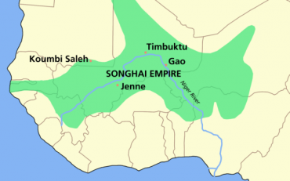
Songhai- A New Empire
In 14th century Songhai became the new trading empire in West Africa.
The soldier king Sonni Ali used his powerful army to build a largest state that has ever existed in West Africa.
He did not adopt the practices of Islam, he followed traditional African beliefs.

Slide 36
Songhai Grows
Songhai became the largest trading kingdom
Songhai was able to maintain its power over trade because of a strong military
They established a clan system
The clan you belonged to determined your job

Slide 37
Songhai Grows
Soon after his death, the emperor Askia Muhammad set up a Muslim dynasty.
Askia Muhammad also made a pilgrimage to Mecca.
He encouraged the development of Timbuktu as an important center of learning
He was known for giving to the poor

Slide 38
Songhai Falls
Songhai prospered until the mid 1600s
Civil war began to tear Songhai apart
Morocco invaded and preyed upon a weakened Songhai

Slide 39
Stop and Think
Compare and Contrast- What are 3 things that all 3 empires had in common?
How were they different?

